Slide 1
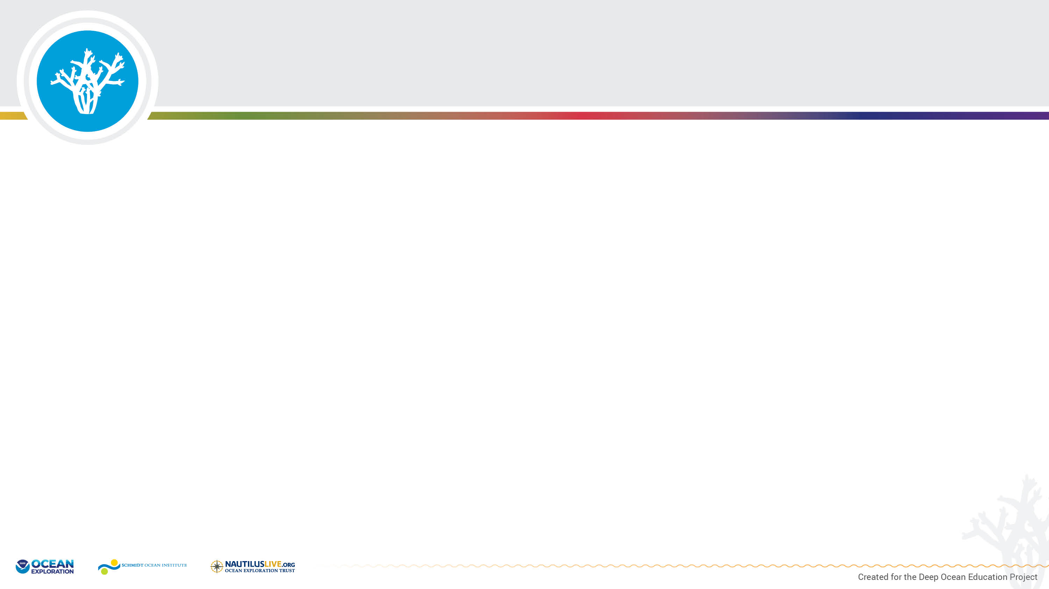
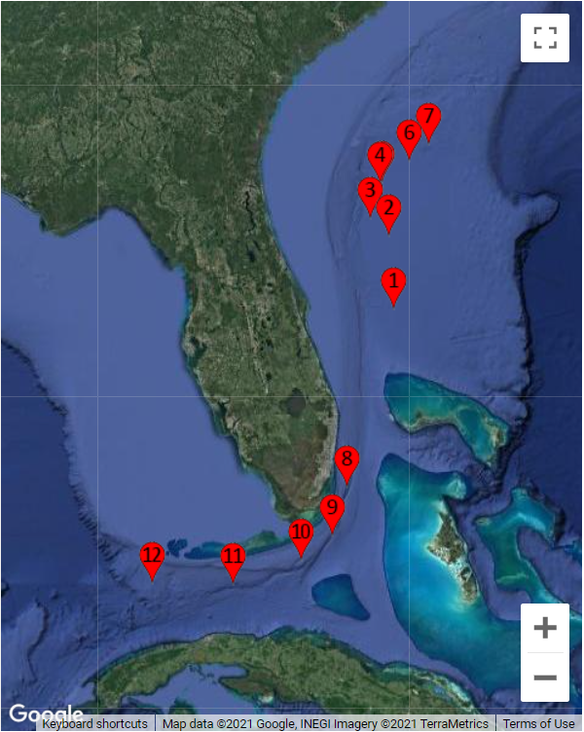
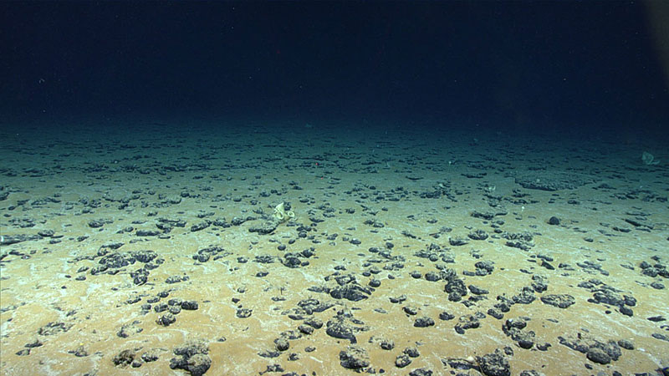
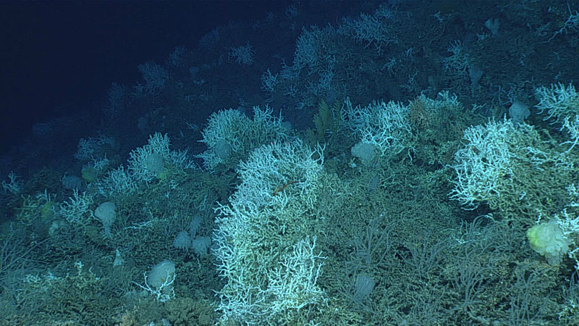
NOAA Ocean Exploration 2019 Southeastern U.S. Deep-sea Exploration
Dive site 7
Dive site 6
The 2019 Southeastern U.S. Deep-sea Exploration Expedition included seafloor mapping and Remotely Operated Vehicle (ROV) dives (each dive numbered and indicated by the red markers) in the deep water habitats off the coast of South Carolina, Georgia, and Florida. https://oceanexplorer.noaa.gov/okeanos/explorations/ex1907/logs/summary/summary.html
Notes:
Map image captured from: https://oceanexplorer.noaa.gov/okeanos/explorations/ex1907/welcome.html
Dive 7 - Explored a sandy flat near an area historically subject to the use of experimental deep-sea mining https://oceanexplorer.noaa.gov/okeanos/explorations/ex1907/dailyupdates/nov7/nov7.html
Dive 6 - Remotely Operated Vehicle dive on an isolated coral mound near the center of the Blake Plateau: https://oceanexplorer.noaa.gov/okeanos/explorations/ex1907/dailyupdates/nov6/nov6.html

Slide 2
Lophelia pertusa Friends Student Worksheet
ASSOCIATE SPECIES | HOW THE SPECIES BENEFITS | EVIDENCE FROM IMAGE
Shrimp | Shelter, protection from predators, access to food | The shrimp is crawling among live coral in a position where it could easily hide from a predator as it scavenges for its own food.

Slide 3
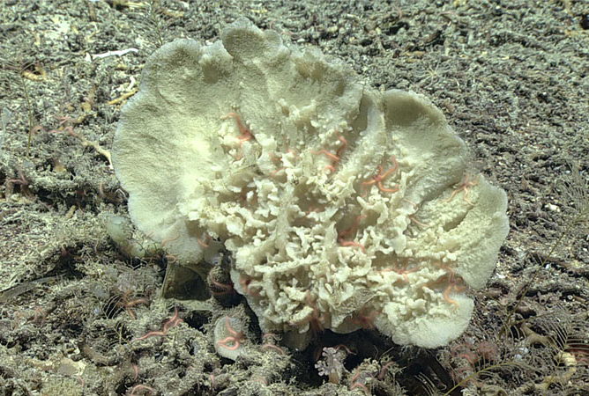
Demosponge
This large demosponge was observed growing on a coral mound in the deep waters off the coasts of South Carolina, Georgia, and Florida. Demosponges come in many shapes and sizes. Like other sponges, this species is a filter feeder and does best in areas where the currents can provide it with the food (particulate organic matter) it needs to survive.
Image courtesy of NOAA Ocean Exploration. https://oceanexplorer.noaa.gov/okeanos/explorations/ex1907/logs/photolog/welcome.html#cbpi=/okeanos/explorations/ex1907/dailyupdates/nov6/media/demosponge.html
Notes:
NOAA Ocean Exploration 2019 Southeastern U.S. Deep-sea Exploration

Slide 4
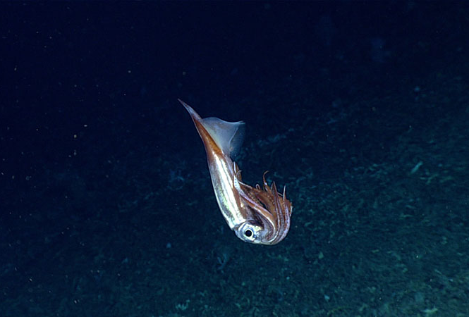
Bird Squid
This bird squid (Ornithoteuthis antillarum) was observed during a dive on an isolated coral mound in the deep waters off the coasts of South Carolina, Georgia, and Florida. The squid is holding its arms and tentacles close to its body, a likely defensive posture assumed in response to the remotely operated vehicle (ROV) in its deep-sea home.
Image courtesy of NOAA Ocean Exploration. https://oceanexplorer.noaa.gov/okeanos/explorations/ex1907/logs/photolog/welcome.html#cbpi=/okeanos/explorations/ex1907/dailyupdates/nov6/media/squid.html
Notes:
NOAA Ocean Exploration 2019 Southeastern U.S. Deep-sea Exploration

Slide 5
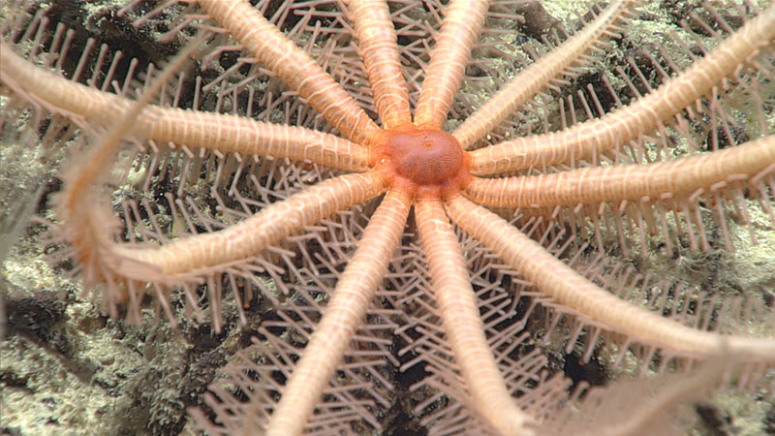
Brisingid Sea Star
This pink 12-armed animal is a brisingid sea star. The spines on its arms are covered with small, claw-like structures that it uses to catch small crustaceans as they swim by in the current. It then uses its tube feet to move its prey down to its mouth (at its center). This sea star was observed hanging out on a deep-sea coral mound located in the deep waters off the coast of South Carolina, Georgia, and Florida.
Image Courtesy of NOAA Ocean Exploration. https://oceanexplorer.noaa.gov/okeanos/explorations/ex1907/logs/photolog/welcome.html#cbpi=/okeanos/explorations/ex1907/dailyupdates/nov6/media/seastar.html
Notes:
NOAA Ocean Exploration 2019 Southeastern U.S. Deep-sea Exploration

Slide 6
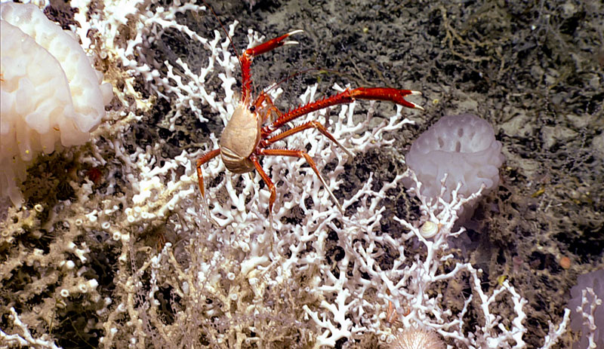
A Variety of Inhabitants
While exploring deep-sea coral mounds off the coast of South Carolina, Georgia, or Florida, scientists found large colonies of Lophelia pertusa deep-sea corals. The coral mounds were also home to high biodiversity, as is evident in this image, which features a variety of Lophelia pertusa inhabitants, including glass sponges, squat lobsters, a snail, an urchin, and more.
Image courtesy of NOAA Ocean Exploration. https://oceanexplorer.noaa.gov/okeanos/explorations/ex1907/logs/photolog/welcome.html#cbpi=/okeanos/explorations/ex1907/dailyupdates/nov6/media/habitat.html
Notes:
NOAA Ocean Exploration 2019 Southeastern U.S. Deep-sea Exploration

Slide 7
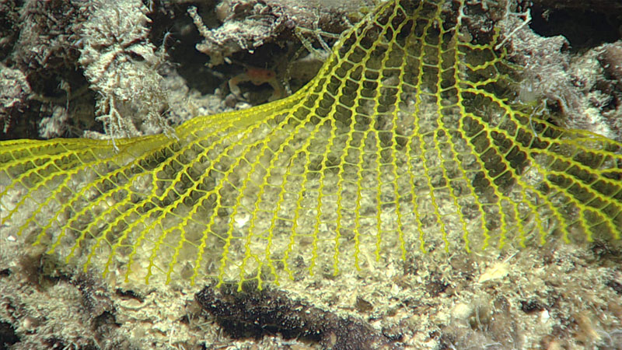
Yellow Mesh Fan
It’s not unusual to come across new species when we explore deep-sea areas that no one has ever been to before. This yellow mesh fan, spotted during a remotely operated vehicle (ROV) dive in the deep waters off the coasts of South Carolina, Georgia, and Florida, is actually an animal - not trash! Scientists were unable to identify the species through the camera, so they collected a sample for further analysis in the lab.
Image courtesy of NOAA Ocean Exploration. https://oceanexplorer.noaa.gov/okeanos/explorations/ex1907/logs/photolog/welcome.html#cbpi=/okeanos/explorations/ex1907/dailyupdates/nov6/media/meshfan.html
Notes:
NOAA Ocean Exploration 019 Southeastern U.S. Deep-sea Exploration

Slide 8
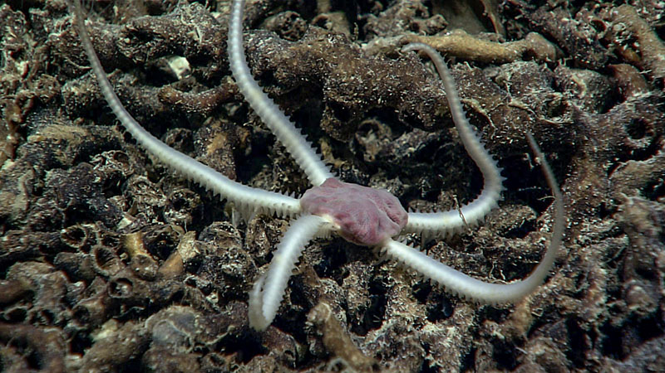
Brittle Star
During a remotely operated vehicle (ROV) dive in the Million Mounds Coral region off the coast of Florida, explorers spotted an abundance of spiky-armed brittle stars with pink central discs moving in the coral rubble. This one was collected from a depth of 822 meters (2,697 feet).
Image courtesy of NOAA Ocean Exploration. https://oceanexplorer.noaa.gov/okeanos/explorations/ex2107/gallery/gallery.html#cbpi=/okeanos/explorations/ex2107/gallery/media/dive14-brittle-star.inc
Notes:
NOAA Ocean Exploration Windows to the Deep 2021

Slide 9
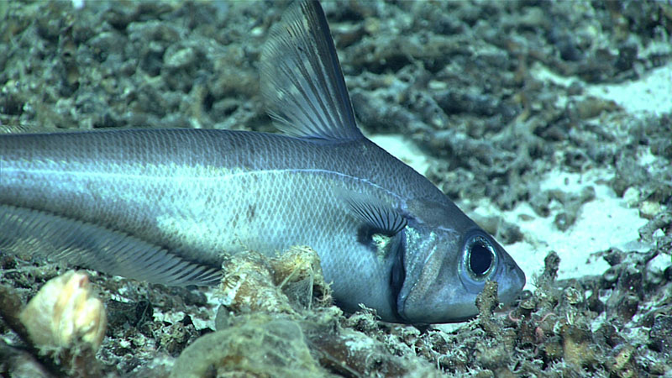
Rattail
Explorers observed many animals within the coral rubble in the Million Mounds coral region during dives with remotely operated vehicles (ROVs). This rattail fish was observed swimming around coral rubble at 822 meters (2,697 feet). During the dive, scientists saw several other species of fish, including cutthroat eels, cusk eels, and even a Darwin’s slimehead.
Image courtesy of NOAA Ocean Exploration. https://oceanexplorer.noaa.gov/okeanos/explorations/ex2107/gallery/gallery.html#cbpi=/okeanos/explorations/ex2107/gallery/media/dive14-rattail.inc
Notes:
NOAA Ocean Exploration Windows to the Deep 2021

Slide 10
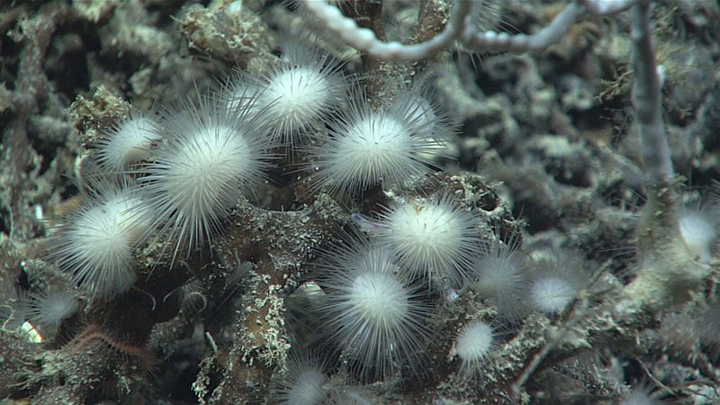
Carnivorous Sponges
This cluster of small, spiky sponges is in the family Cladorhizidae. Cladorhizids are carnivorous sponges that prey on animals such as small crustaceans. This cluster was imaged living on dead coral rubble in the deep waters off the coast of Florida at 825 meters (2,707 feet).
Image courtesy of NOAA Ocean Exploration. https://oceanexplorer.noaa.gov/okeanos/explorations/ex2107/gallery/gallery.html#cbpi=/okeanos/explorations/ex2107/gallery/media/dive14-sponges.inc
Notes:
NOAA Ocean Exploration Windows to the Deep 2021

Slide 11
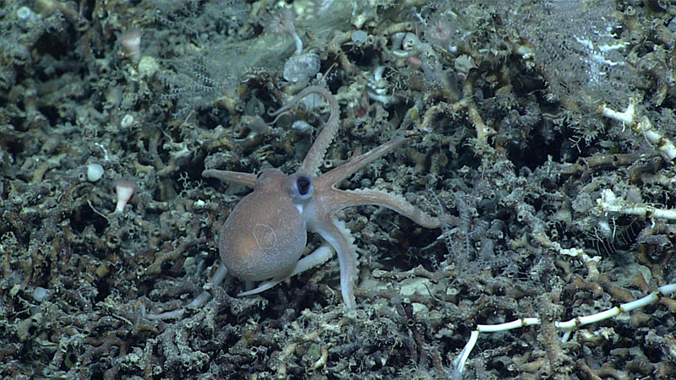
Juvenile Octopus
This juvenile octopus, Muusoctopus januarii, was observed exploring its surroundings on a small ridge of deep-sea coral reef mounds off the coasts of South Carolina and Georgia.
Image courtesy of NOAA Ocean Exploration. https://oceanexplorer.noaa.gov/okeanos/explorations/ex2107/gallery/gallery.html#cbpi=/okeanos/explorations/ex2107/gallery/media/dive01-octopus.inc
Notes:
NOAA Ocean Exploration Windows to the Deep 2021

Slide 12
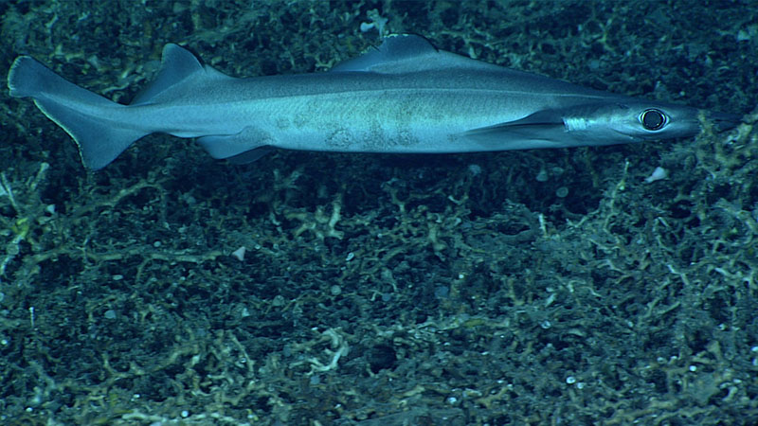
Birdbeak Dogfish Shark
A birdbeak dogfish shark was seen making its way over dead coral rubble that covered the seafloor for much of the first half of a remotely operated vehicle (ROV) dive on a small ridge of deep-sea coral mounds located off the coasts of South Carolina and Georgia. This shark, with its large eyes, was seen at a depth of approximately 860 meters (2,821 feet).
Image courtesy of NOAA Ocean Exploration. https://oceanexplorer.noaa.gov/okeanos/explorations/ex2107/gallery/gallery.html#cbpi=/okeanos/explorations/ex2107/gallery/media/dive01-shark.inc
Notes:
NOAA Ocean Exploration Windows to the Deep 2021

Slide 13
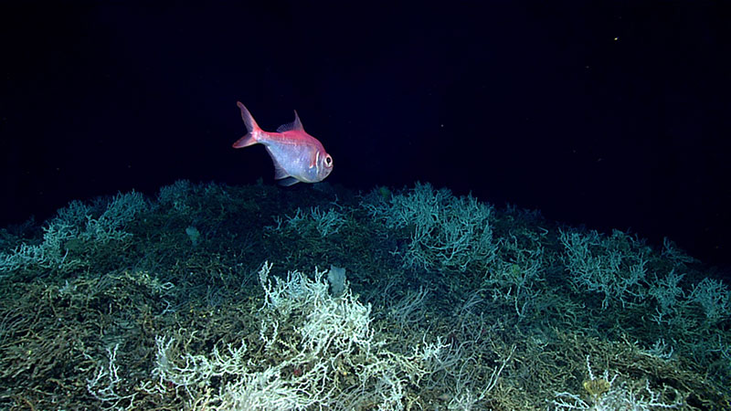
Alfonsino Fish
Alfonsino fish are a commercially important species. This fish was seen swimming over a thicket of Lophelia pertusa during a remotely operated vehicle (ROV) dive on a cold water deep-sea coral mound located off the coasts of South Carolina, Georgia, and Florida.
Image courtesy of NOAA Ocean Exploration. https://oceanexplorer.noaa.gov/okeanos/explorations/ex1903/logs/photolog/welcome.html#cbpi=/okeanos/explorations/ex1903/logs/july9/media/fish.html
Notes:
NOAA Ocean Exploration Windows to the Deep 2019

Slide 14
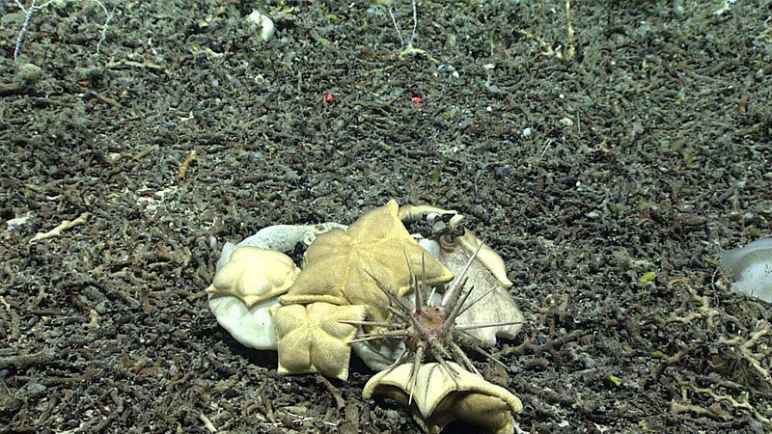
Cidaroid Sea Urchin
While exploring deep-sea coral mounds off the coasts of the Southeastern United States explorers observed a massive sea urchin, from the order Cidaroida, and at least six other individuals. A number of sea stars called cookie stars (Plinthaster dentatus) were also observed feeding on a sponge.
Image courtesy of NOAA Ocean Exploration. https://oceanexplorer.noaa.gov/okeanos/explorations/ex1903/logs/photolog/welcome.html#cbpi=/okeanos/explorations/ex1903/logs/july4/media/feeding.html
Notes:
NOAA Ocean Exploration Windows to the Deep 2019

Slide 15
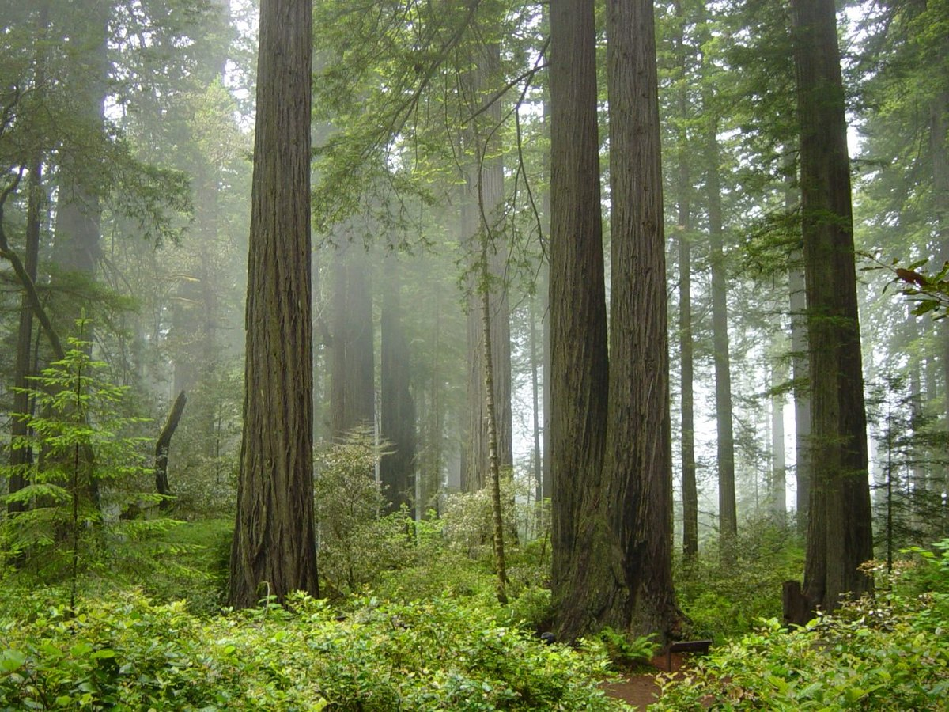
Laying the Foundation: Redwoods
Coast Redwood forest and understory plants in Redwood National Park, California
Environment:
Coastal forests of Northern California
Effects
Coexist with various hardwoods that differ from coastal to inland side of forest
Provide habitat for many mammals, birds, insects, and other organisms
Image from: https://commons.wikimedia.org/wiki/File:Redwood_National_Park,_fog_in_the_forest.jpg
Information from: https://esajournals.onlinelibrary.wiley.com/doi/epdf/10.1890/1540-9295%282005%29003%5B0479%3ALOFSCF%5D2.0.CO%3B2
Notes:
Image from: https://commons.wikimedia.org/wiki/File:Redwood_National_Park,_fog_in_the_forest.jpg
Information from: https://esajournals.onlinelibrary.wiley.com/doi/epdf/10.1890/1540-9295%282005%29003%5B0479%3ALOFSCF%5D2.0.CO%3B2

Slide 16
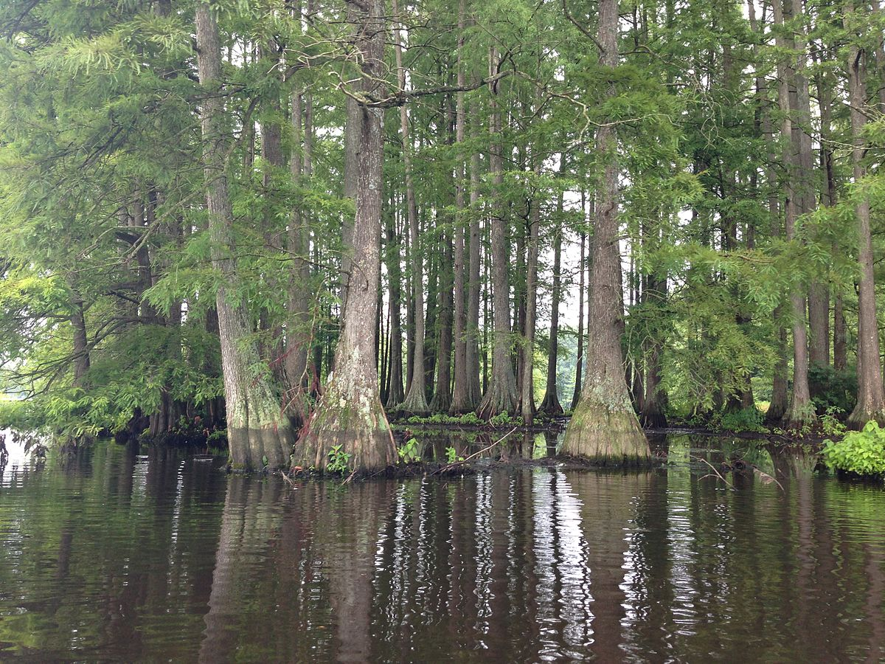
Laying the Foundation: Bald Cypress
Cluster of bald cypress trees in Trap Pond State Park near Laurel, Delaware
Environment:
Found in deepwater swamps of southeastern North America
Effects:
Regulate the water table level and flow of sediment and nutrients
Control structure and composition of associated plant and animal communities
Image from: https://commons.wikimedia.org/wiki/File:Bald_Cypress.JPG
Information from: https://esajournals.onlinelibrary.wiley.com/doi/epdf/10.1890/1540-9295%282005%29003%5B0479%3ALOFSCF%5D2.0.CO%3B2
Notes:
Image from: https://commons.wikimedia.org/wiki/File:Bald_Cypress.JPG
Information from: https://esajournals.onlinelibrary.wiley.com/doi/epdf/10.1890/1540-9295%282005%29003%5B0479%3ALOFSCF%5D2.0.CO%3B2

Slide 17
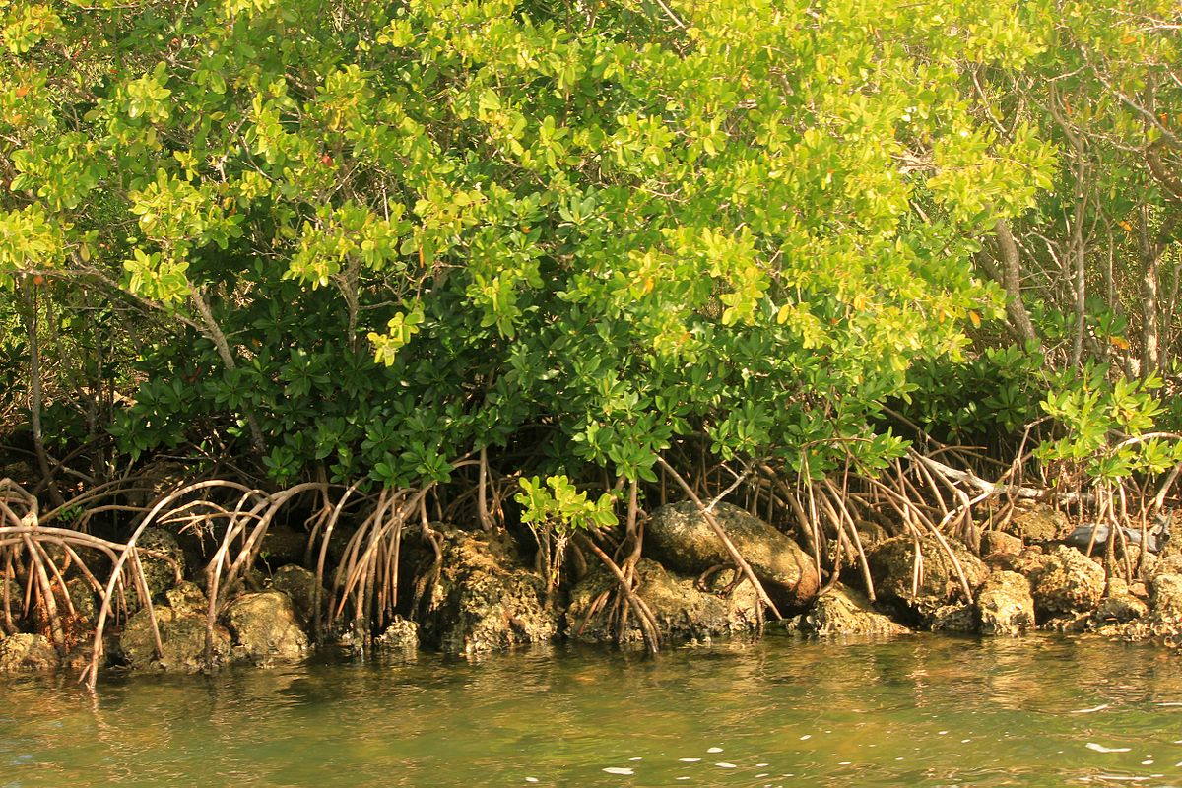
Laying the Foundation: Mangroves
Mangroves and roots in Biscayne National Park in Florida
Environment:
Estuarine and coastal forests throughout the tropics
Effects:
Extremely high net primary productivity
Slow movement of tidal waters stabilize shoreline
Provides habitat for fish and other species
Image from: https://commons.wikimedia.org/wiki/File:Gfp-florida-biscayne-national-park-mangroves.jpg
Information from: https://esajournals.onlinelibrary.wiley.com/doi/epdf/10.1890/1540-9295%282005%29003%5B0479%3ALOFSCF%5D2.0.CO%3B2 and https://oceanservice.noaa.gov/facts/mangroves.html
Notes:
Image from: https://commons.wikimedia.org/wiki/File:Gfp-florida-biscayne-national-park-mangroves.jpg
Information from: https://esajournals.onlinelibrary.wiley.com/doi/epdf/10.1890/1540-9295%282005%29003%5B0479%3ALOFSCF%5D2.0.CO%3B2 and https://oceanservice.noaa.gov/facts/mangroves.html

Slide 18
Laying the Foundation: Lophelia pertusa
Characteristics of Lophelia pertusa
Benefits of Lophelia pertusa to other species
Leads to

Slide 19
Laying the Foundation: ________________________________
Characteristics of My Chosen Species
Benefits of My Chosen Species to other species
Leads to

