Slide 1
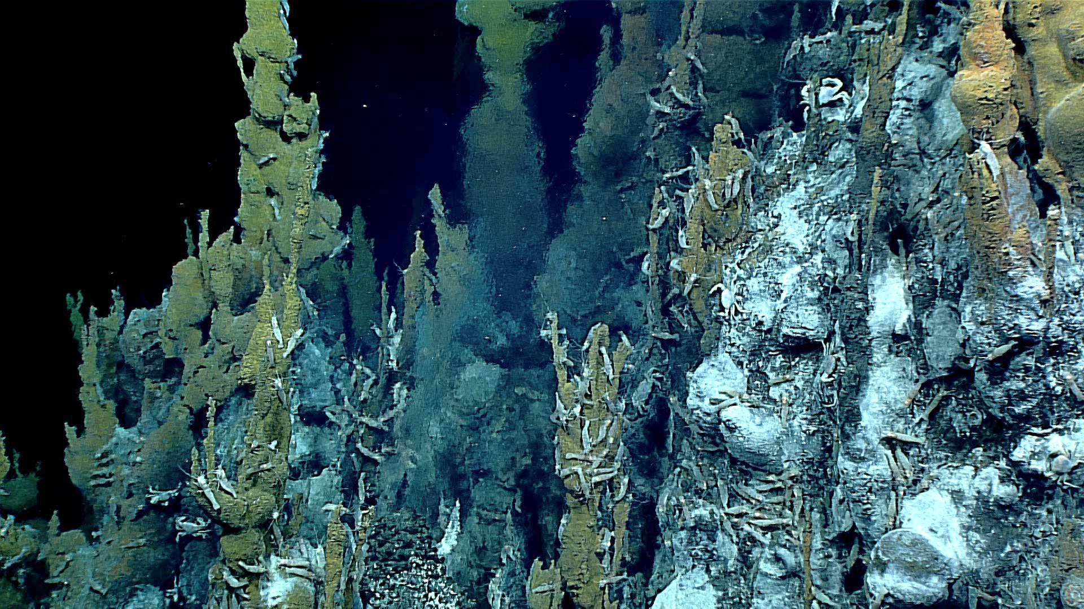
Using Chemistry to Find Vents
Notes:
Methane hydrate (frozen methane) and methane gas at Astoria Canyon Floor (video): https://www.youtube.com/watch?v=OazBJkRIAmA&t=1s

Slide 2
Vents - Experience the Phenomenon

Slide 3
Vents - Experience the Phenomenon
https://oceanexplorer.noaa.gov/okeanos/explorations/ex1605/logs/may12/media/video/vents-1280x720.mp4

Slide 4
Vents - Experience the Phenomenon
Question: How do chemical cues help scientists locate hydrothermal vents and other unique deep seafloor habitats?
Let’s think about it!
What makes you think about that idea?
What evidence or information helps support your proposed idea(s) of how to find hydrothermal vents?
How does this evidence connect to what they already know?
What more is needed to answer the driving question?

Slide 5
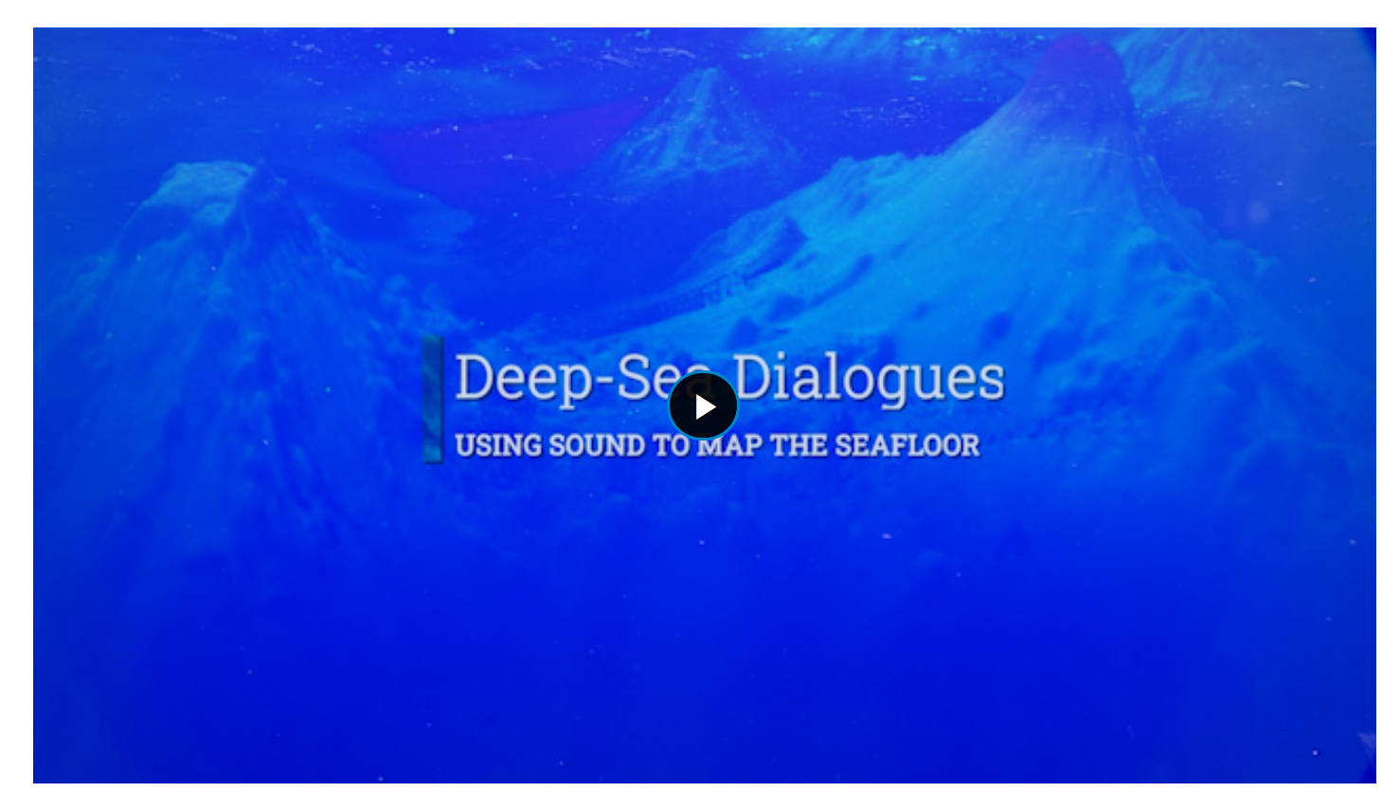
Vents - Experience the Phenomenon
https://oceanexplorer.noaa.gov/edu/multimedia-resources/dsd/media/2023-DSD-Mapping-v6-1920x1080.mp4

Slide 6
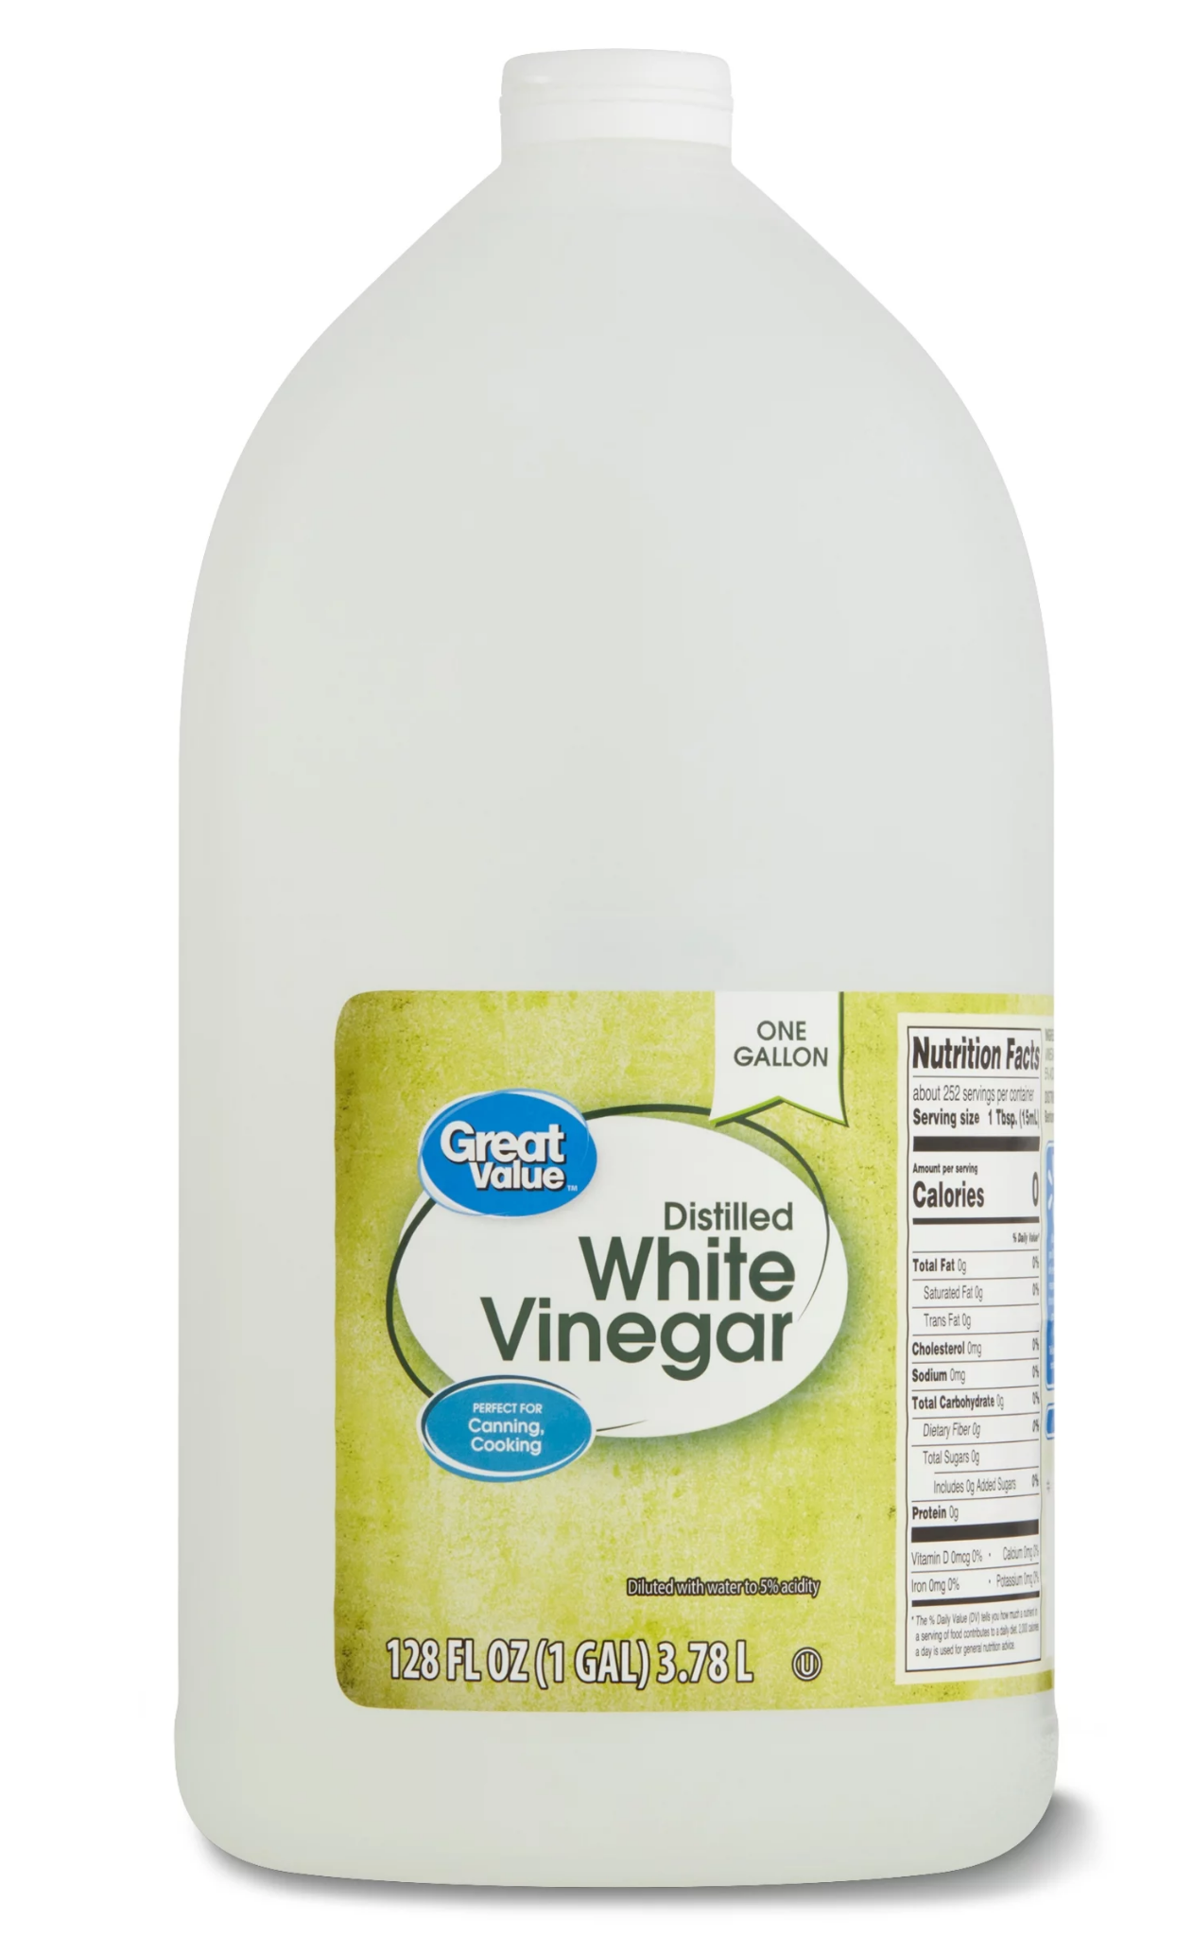
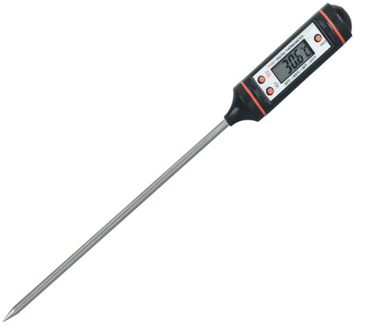
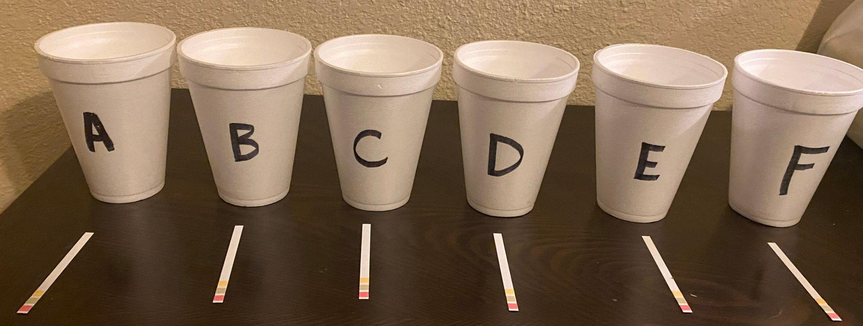
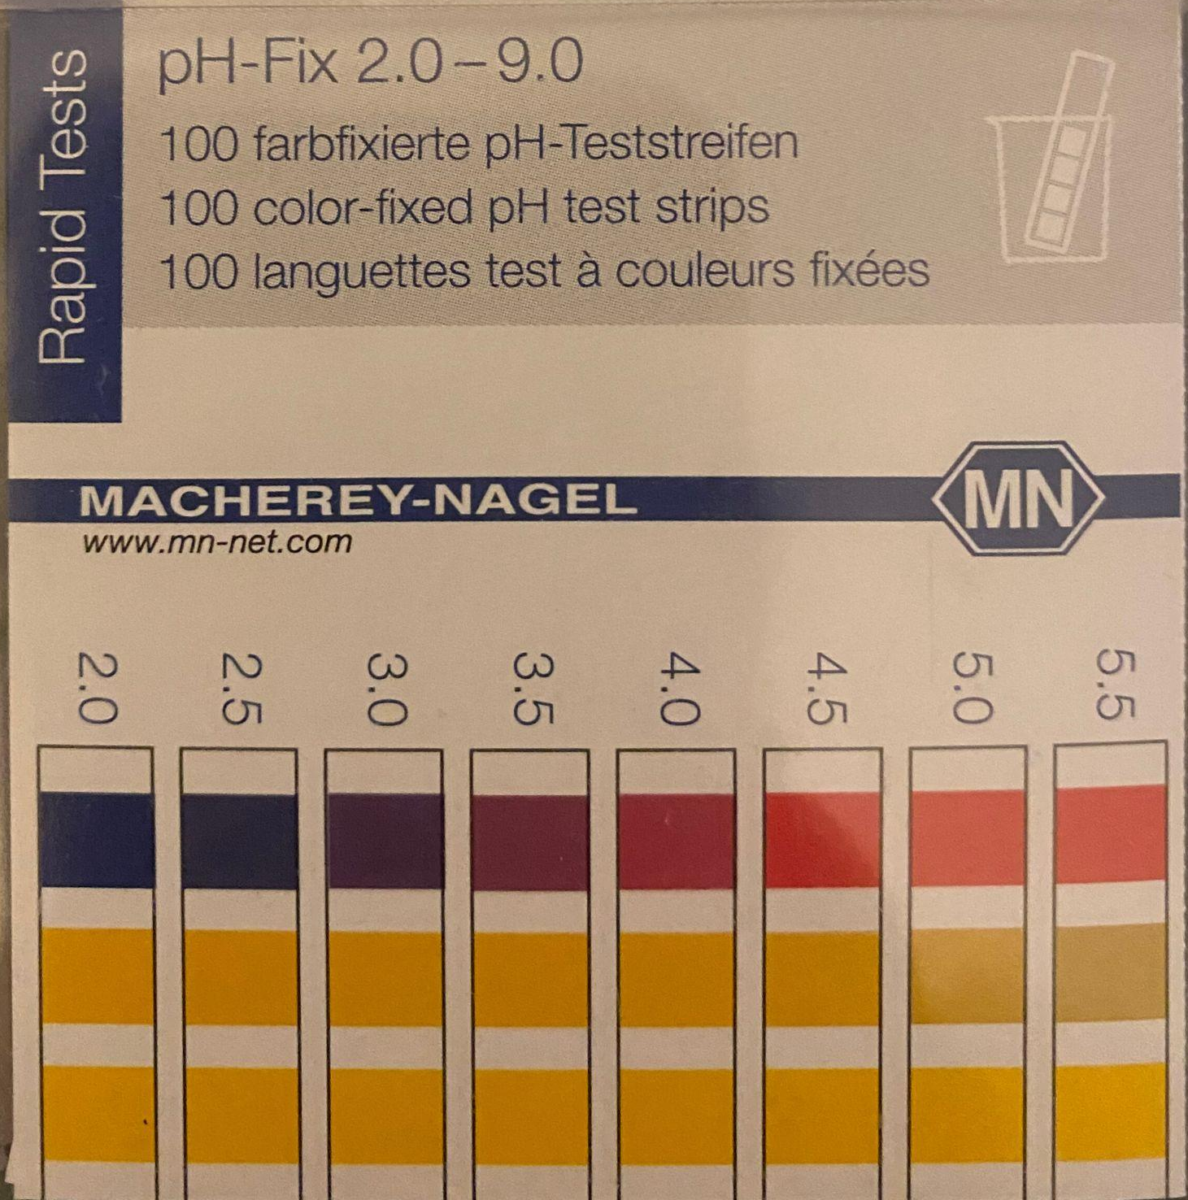
Vents - Investigate

Slide 7
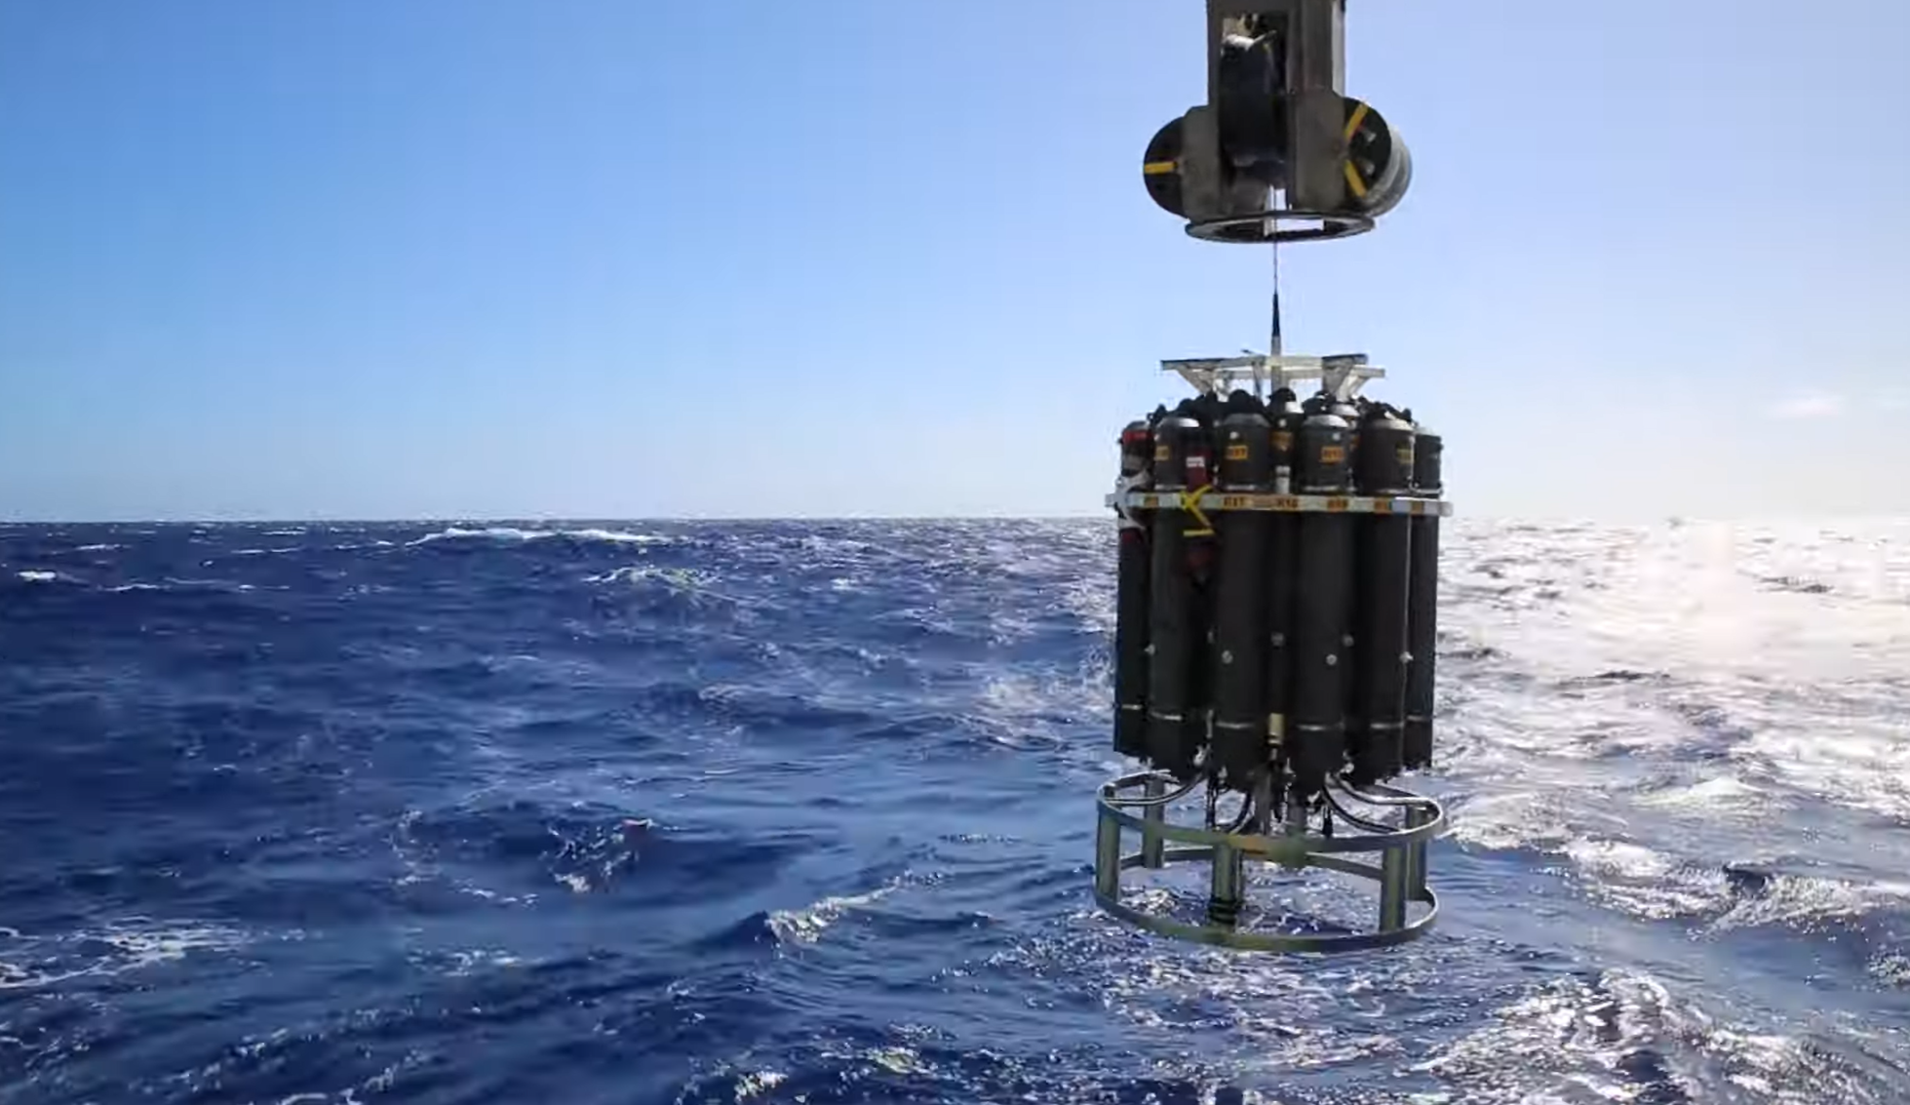
Vents - Investigate
https://oceanexplorer.noaa.gov/technology/ctd/ctd.html

Slide 8
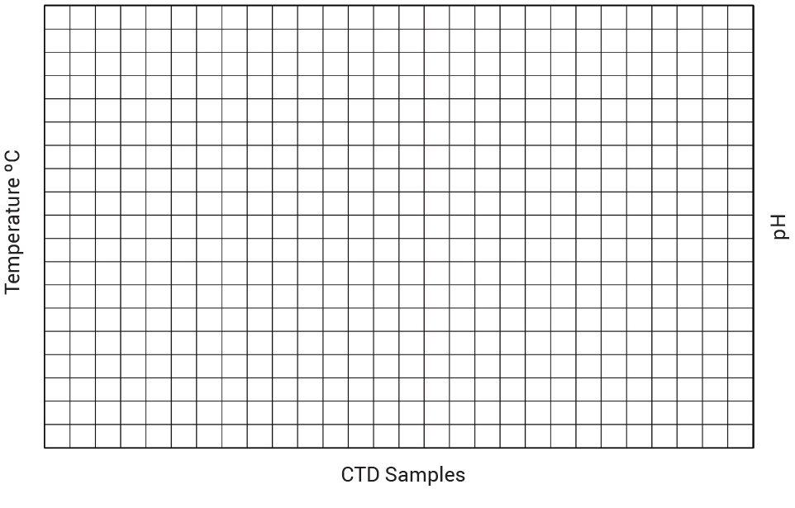
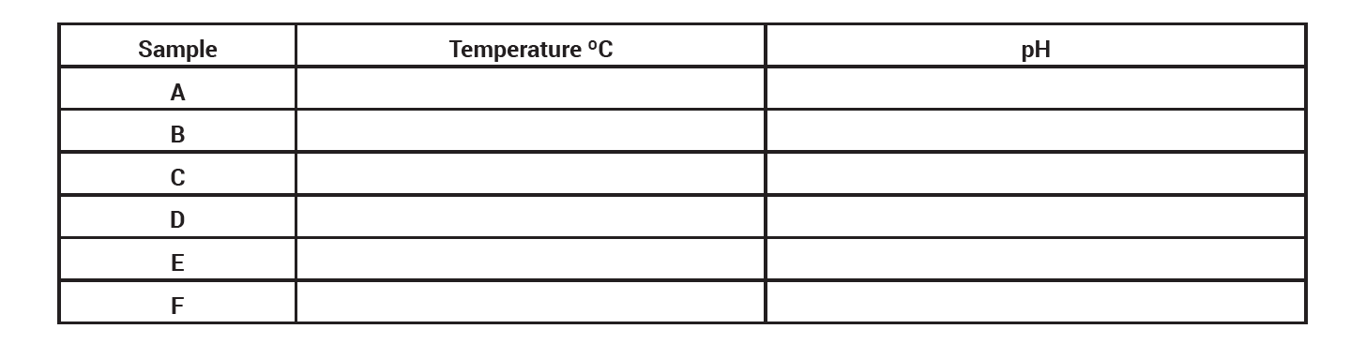
Vents - Investigate
Collecting data and graphing results

Slide 9
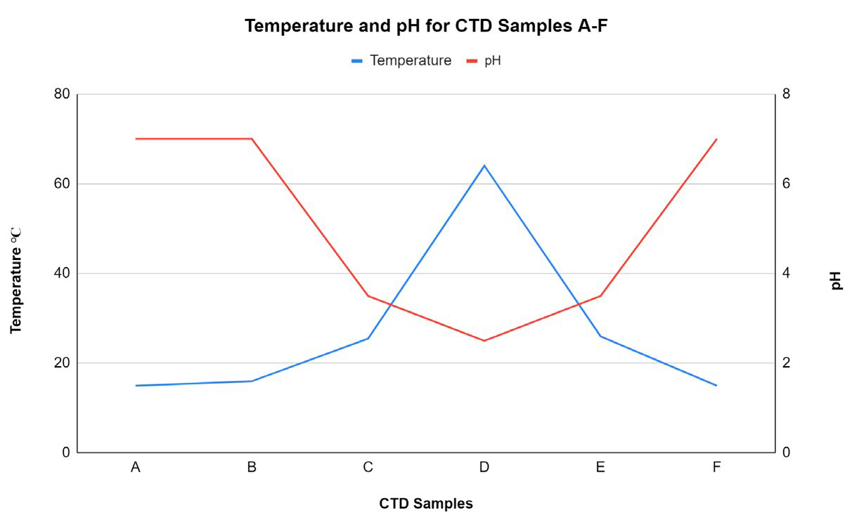
Vents - Investigate

Slide 10
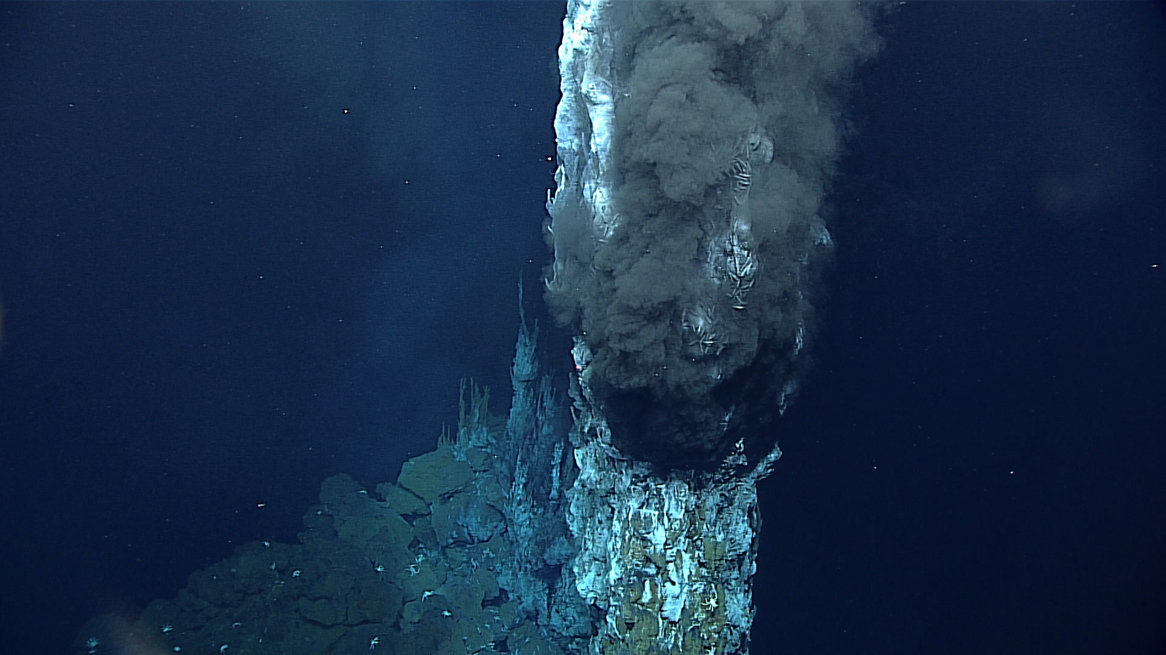
Vents - Put the Pieces Together
Draw a model of how your data could indicate the presence of a hydrothermal vent and discuss with your group.
Include:
Ship
A CTD sampling the water
A-F data points
Location in the water column where these samples could have been collected.
Vent location - based on you data

Slide 11
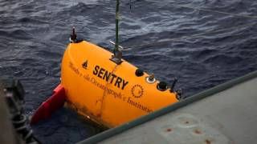
Vents - Put the Pieces Together
https://www.youtube.com/watch?v=YDyWrwO4nJA&t=4s

