Slide 1
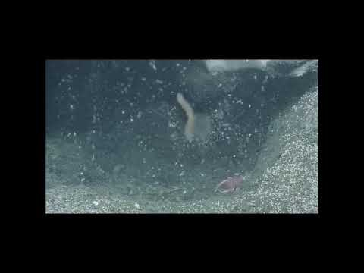
Experience the Phenomenon: Making Observations
0:25 -0:50 min no sound
Source: https://www.youtube.com/watch?v=OazBJkRIAmA&t=1s
Notes:
Methane hydrate (frozen methane) and methane gas at Astoria Canyon Floor (video): https://www.youtube.com/watch?v=OazBJkRIAmA&t=1s

Slide 2
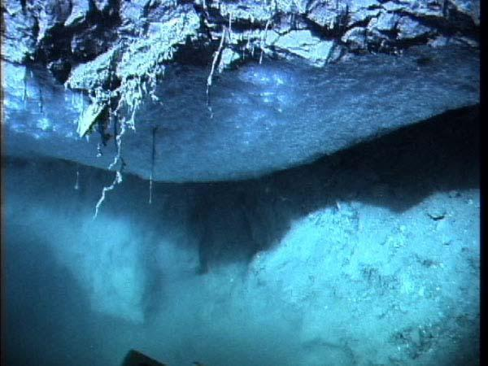
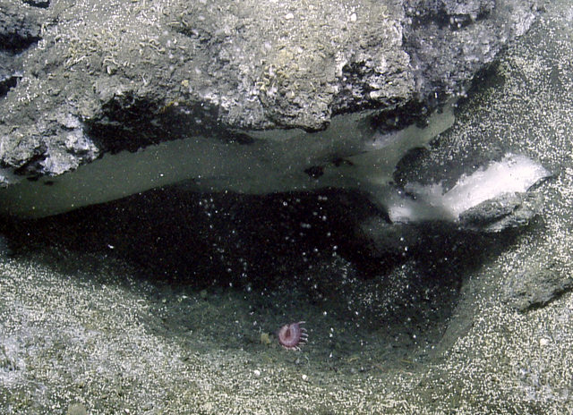
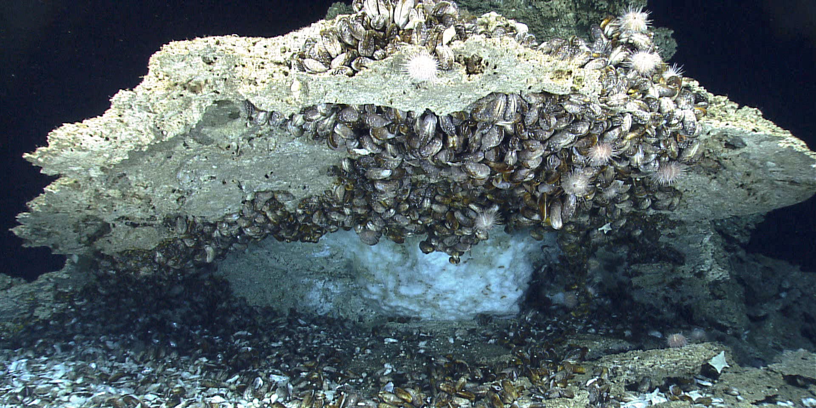
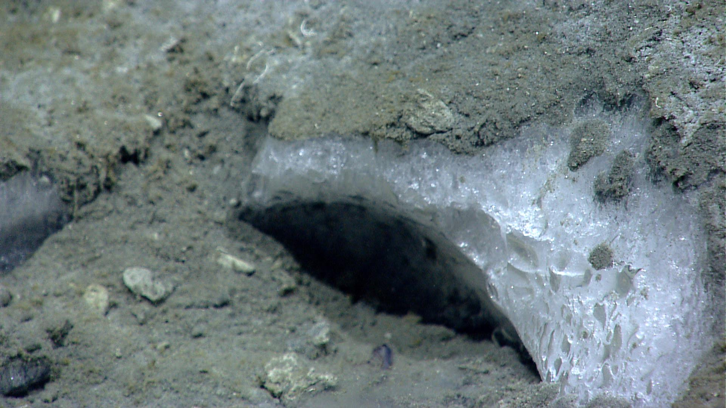
What do you see? What questions do you have?
https://oceanexplorer.noaa.gov/explorations/deepeast01/logs/sep27/media/hydrateoverhang.html
https://www.pmel.noaa.gov/eoi/Cascadia-margin.html
https://oceanexplorer.noaa.gov/okeanos/explorations/ex1402/logs/apr12/apr12.html
https://oceanexplorer.noaa.gov/okeanos/explorations/ex1304/dailyupdates/dailyupdates.html#cbpi=july11.html

Slide 3
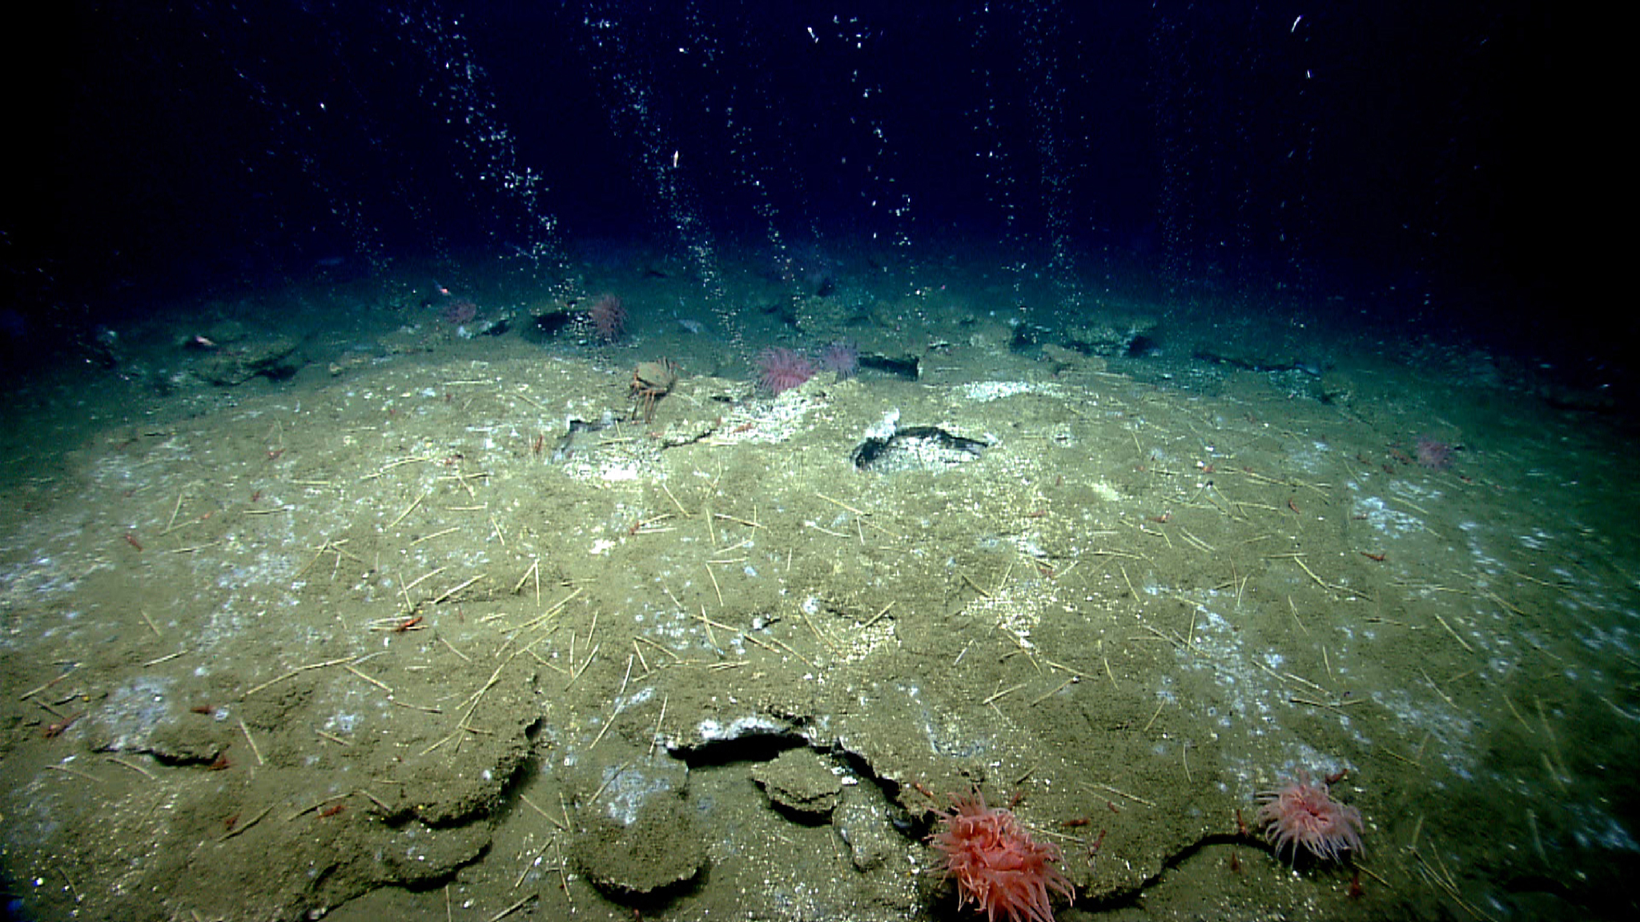
Background: Cold Seeps
Cold Seeps
  places where hydrogen sulfide, methane, and other hydrocarbon-rich fluids and/or gases escape from cracks in the ocean floor
Methane Cold Seep
  characterized by methane and hydrogen sulfide bubbles coming out of the seafloor
  chemicals provide energy for chemosynthetic ecosystems
Image courtesy of NOAA Ocean Exploration;
https://oceanexplorer.noaa.gov/okeanos/explorations/ex1903/background/seeps/welcome.html

Slide 4
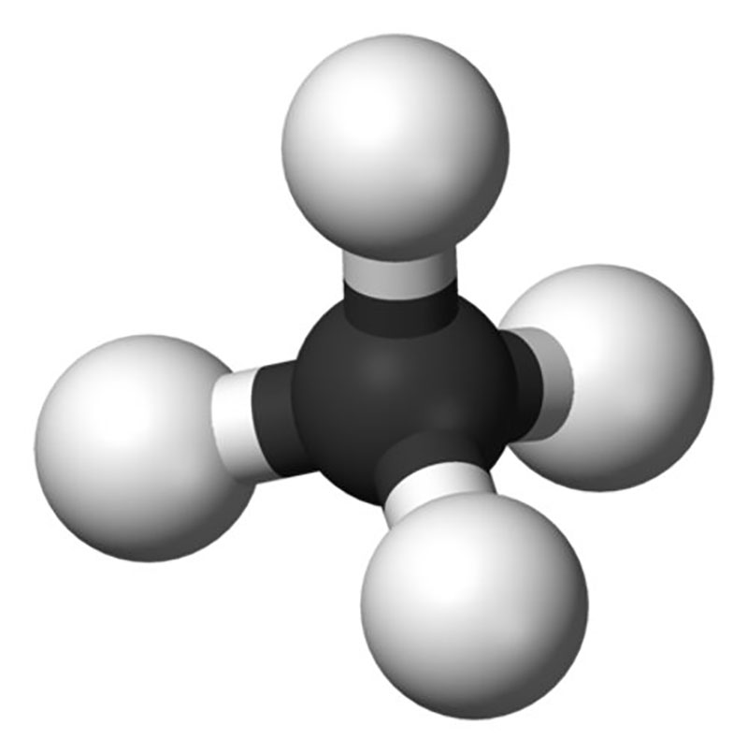
What is a Methane Hydrate?
Methane Structure
Methane hydrates are ice-like crystal structures made of water and methane gas.
  Methane gas is produced by biological activity in sediments conducted by microorganisms.
Why are they important?
  May contain 2X the carbon contained in all reserves of coal, oil, & conventional natural gas combined, making them a potentially valuable energy resource.
  Their decomposition can release large amounts of methane, which is a greenhouse gas that could impact Earth’s climate.
  Can be associated with unusual and possibly unique biological communities that use hydrocarbons or hydrogen sulfide for carbon & energy, via chemosynthesis.
But how does methane hydrate form on and below the ocean seafloor?

Slide 5
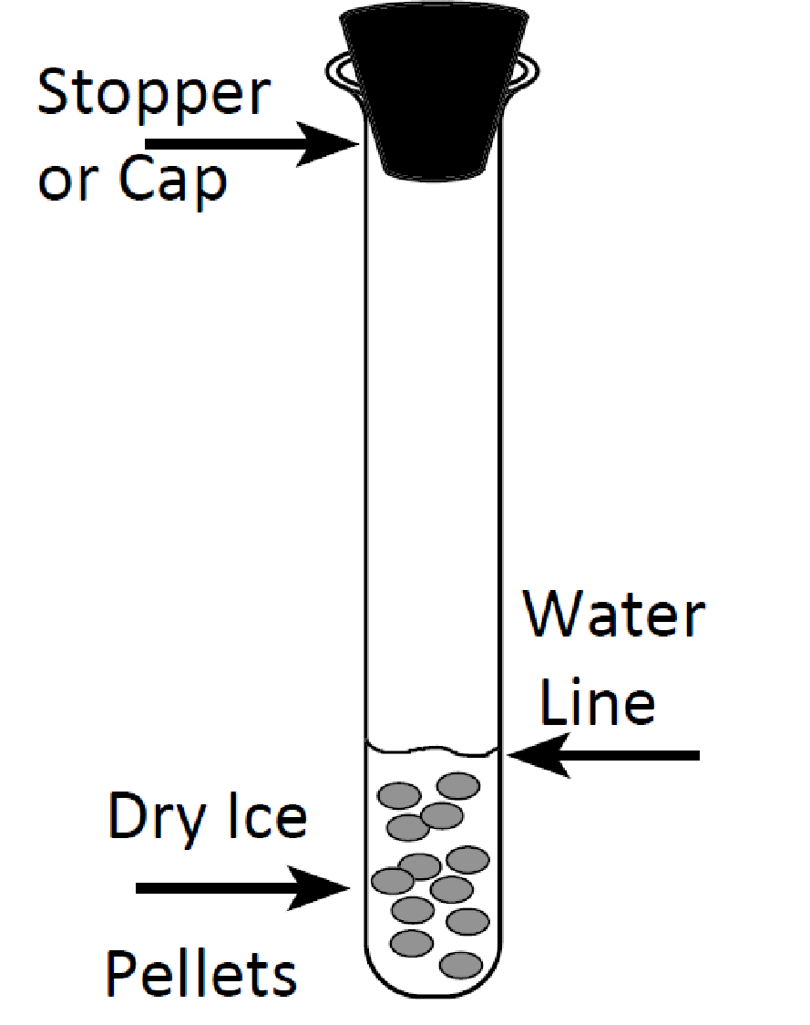
Investigate: Diagram of Lab Set-up

Slide 6
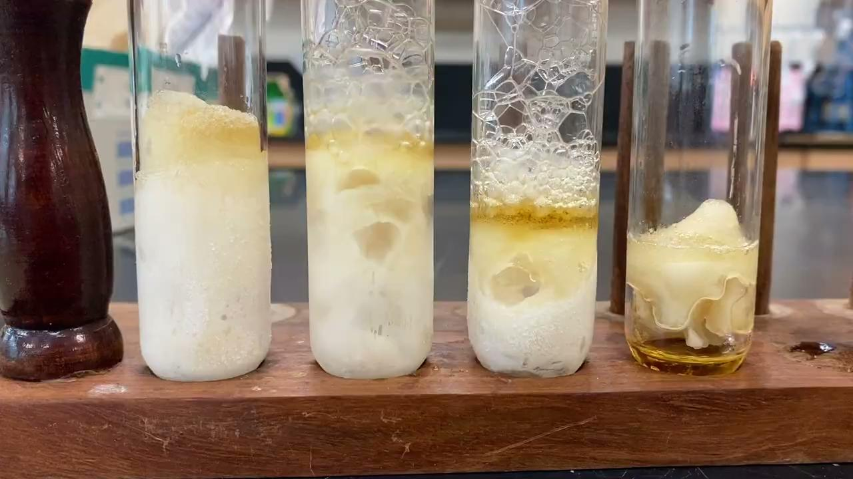
Investigate: Methane Hydrate Lab Video
Source: https://oceanexplorer.noaa.gov/edu/materials/methane-hydrate-formation-demonstration.mp4

Slide 7
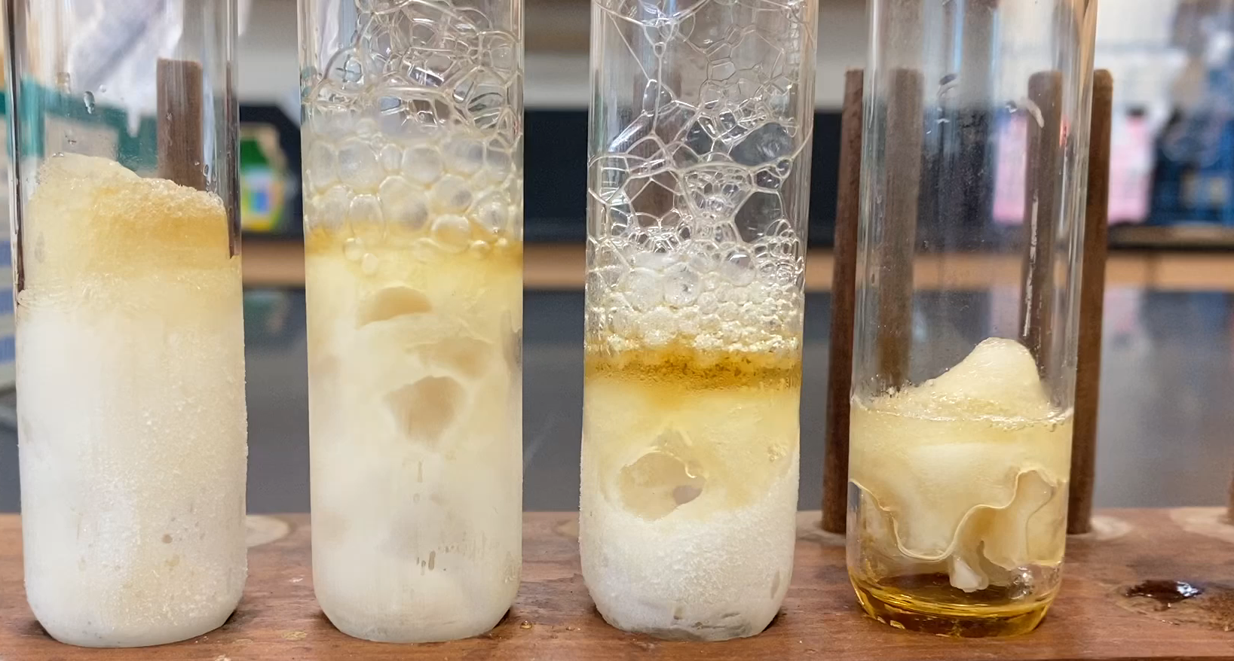
Investigate: Methane Hydrate Lab Images
Only ice and coffee water left.
Solid
Model “Hydrate”
“Hydrate” begins to melt.
Continues to melt.

Slide 8
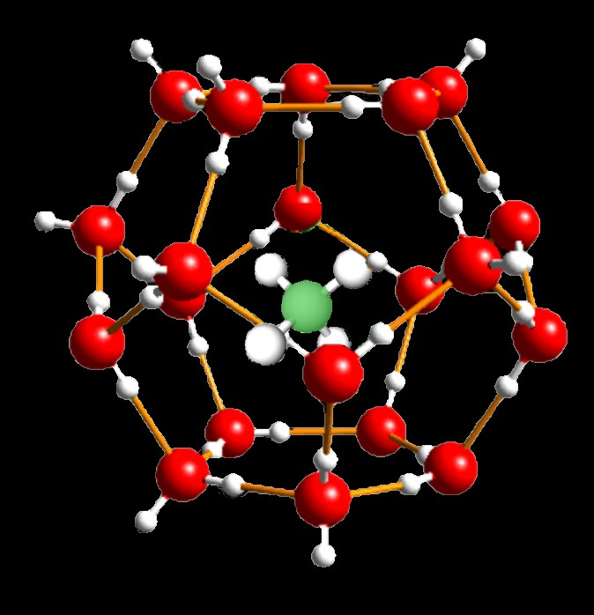
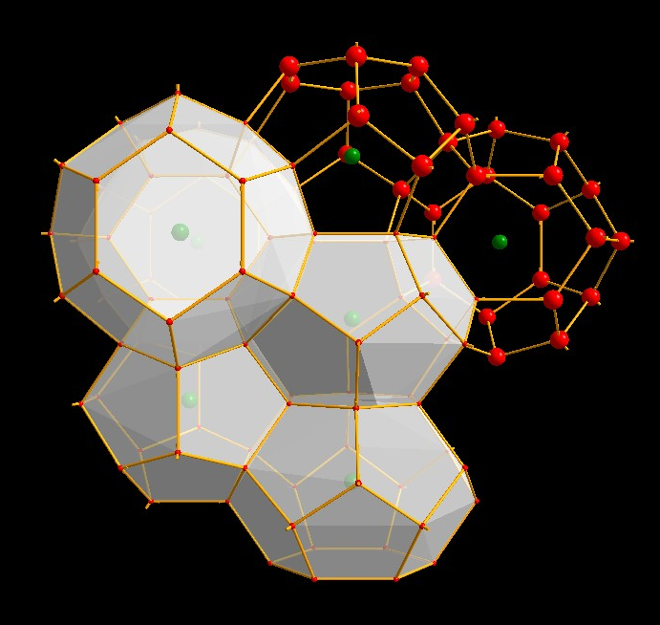
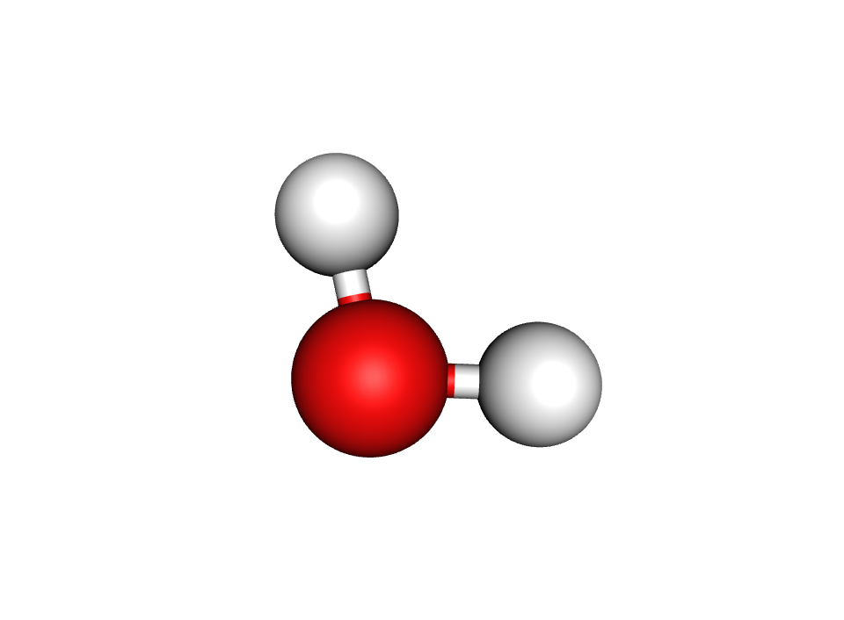
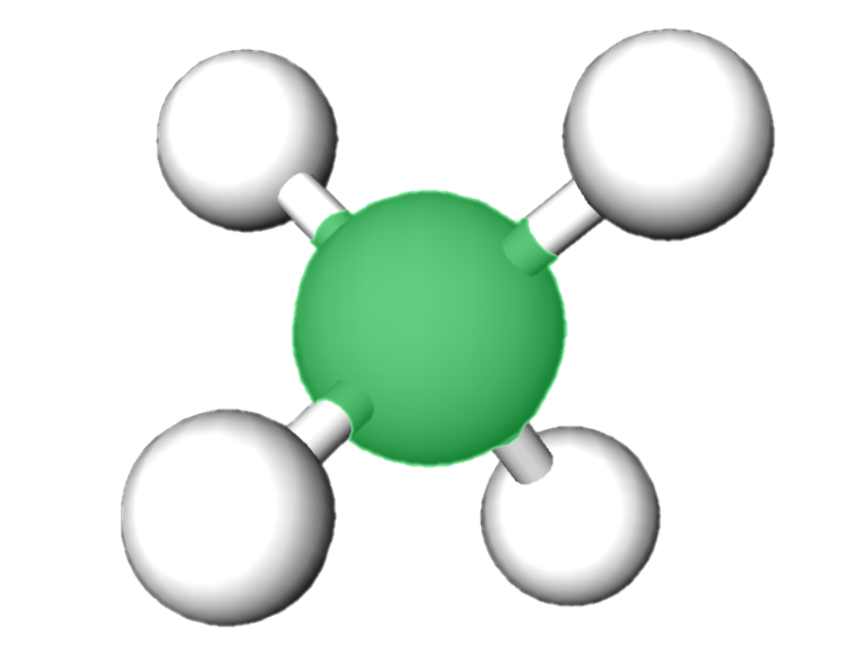
Investigate: Chemical Structures
water molecules
methane molecules
Methane hydrate crystal structure.
Water molecules (1 red oxygen and 2 white hydrogens) around a methane molecule (1 green carbon and 4 white hydrogens).
https://www.usgs.gov/media/images/hydrate-molecule
Methane hydrate repeating crystal structure.
Water molecules (red spheres) form a pentagonal dodecahedron around a methane molecule (green spheres).
Author: Andrzej Falenty
https://commons.wikimedia.org/wiki/File:CH4_hydrate_sI.jpg
Individual water and methane molecules.

Slide 9
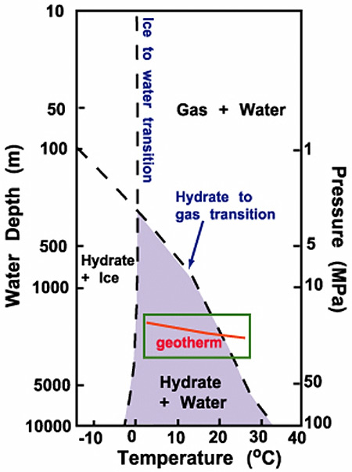
Investigate: Phase Change Diagrams
Adapted from https://oceanexplorer.noaa.gov/explorations/03windows/background/hydrates/media/fig1_phase_diagram.html

Slide 10
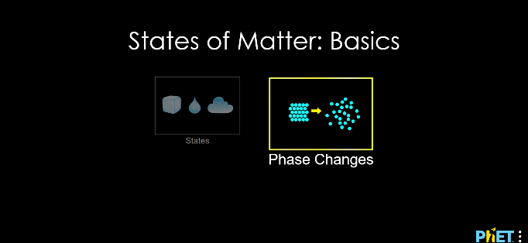
Phase Change Simulation: Optional
https://phet.colorado.edu/sims/html/states-of-matter-basics/latest/states-of-matter-basics_en.html

Slide 11
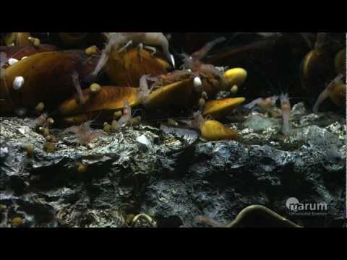
Put the Pieces Together: Cold Seeps and Methane Hydrates
0:30 – 3:17 min
Source: https://www.youtube.com/watch?v=ahmjHLyF9GM

