Slide 1
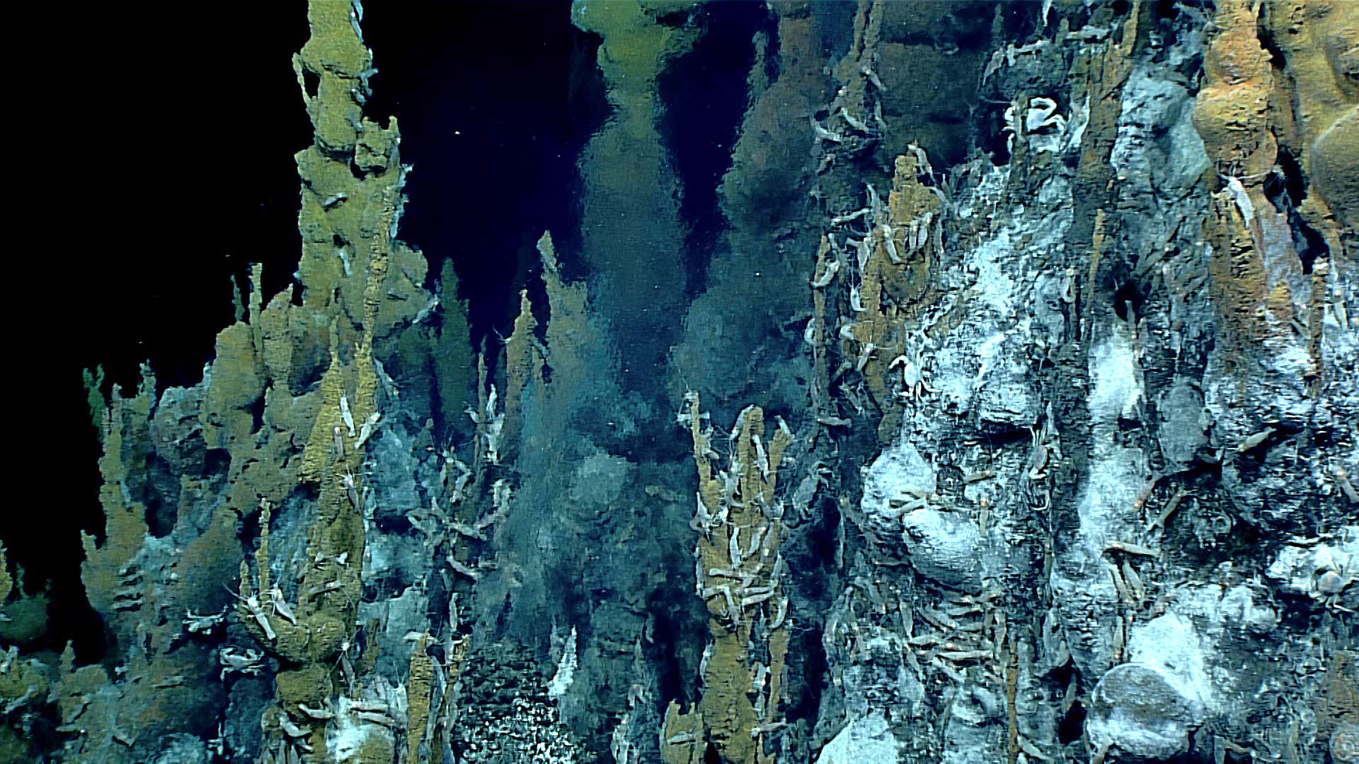
Fueling Life on Earth
Fueling Life on Earth
Photosynthesis vs Chemosynthesis

Slide 2

Introduction
Introduction
Ecosystems depend on some organisms to convert inorganic compounds into food that other organisms can eat.
The majority of life on Earth is based on a food web which revolves around the Sun, as plants use sunlight to make food.
What is this process called?
What does the sunlight provide to most ecosystems?
What do the plants and algae do with that sunlight? What do they create?

Slide 3
Introduction
Introduction
What happens to the environment, i.e. what changes, as the ocean gets deeper?
Do you think there are animals in the deep sea?
If there is no light in the deep sea, can photosynthesis occur?
If there is life in the deep sea but photosynthesis does not occur, then what do organisms rely on for primary production?
Notes:
What happens to the environment, i.e. what changes, as the ocean gets deeper? Answers may include: it gets colder, the pressure is get higher, and it gets darker (no light). Focus on the “gets darker - no light”

Slide 4
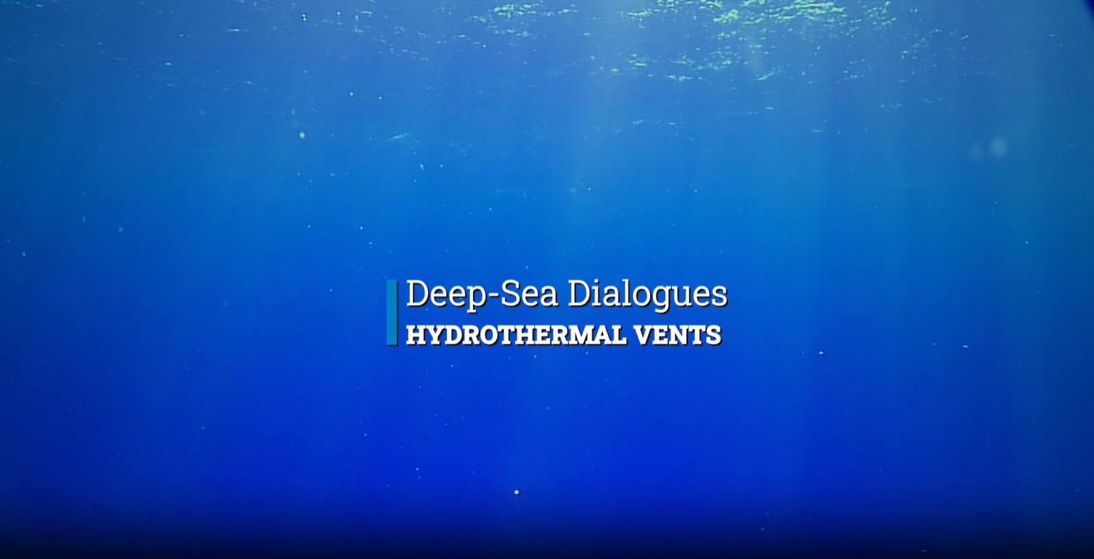
Introduction
Introduction
Notes:
VIDEO: https://oceanexplorer.noaa.gov/edu/multimedia-resources/dsd/media/hydrothermal-vents-1920x1080.mp4
Play 5:50-8:30 min

Slide 5
Introduction
Introduction
How do animal near vents get their energy?
What uses the special process to create energy?
So, what is the base of the food chain down at hydrothermal vent sites?
Notes:
How do animal near vents get their energy?
Chemosynthesis
What uses the special process to create energy?
Bacteria
So, what is the base of the food chain down at hydrothermal vent sites?
Bacteria

Slide 6
Introduction
Introduction
PHOTO (light) and SYNTHESIS (put things together/build).
  Uses light energy to make food/sugar.
CHEMO (chemical) and SYNTHESIS (put things together/build)
  Uses chemical energy to make food/sugar.

Slide 7
Learning Procedure
Learning Procedure
DRIVING QUESTION
How does the process of photosynthesis compare to chemosynthesis in the deep sea?

Slide 8
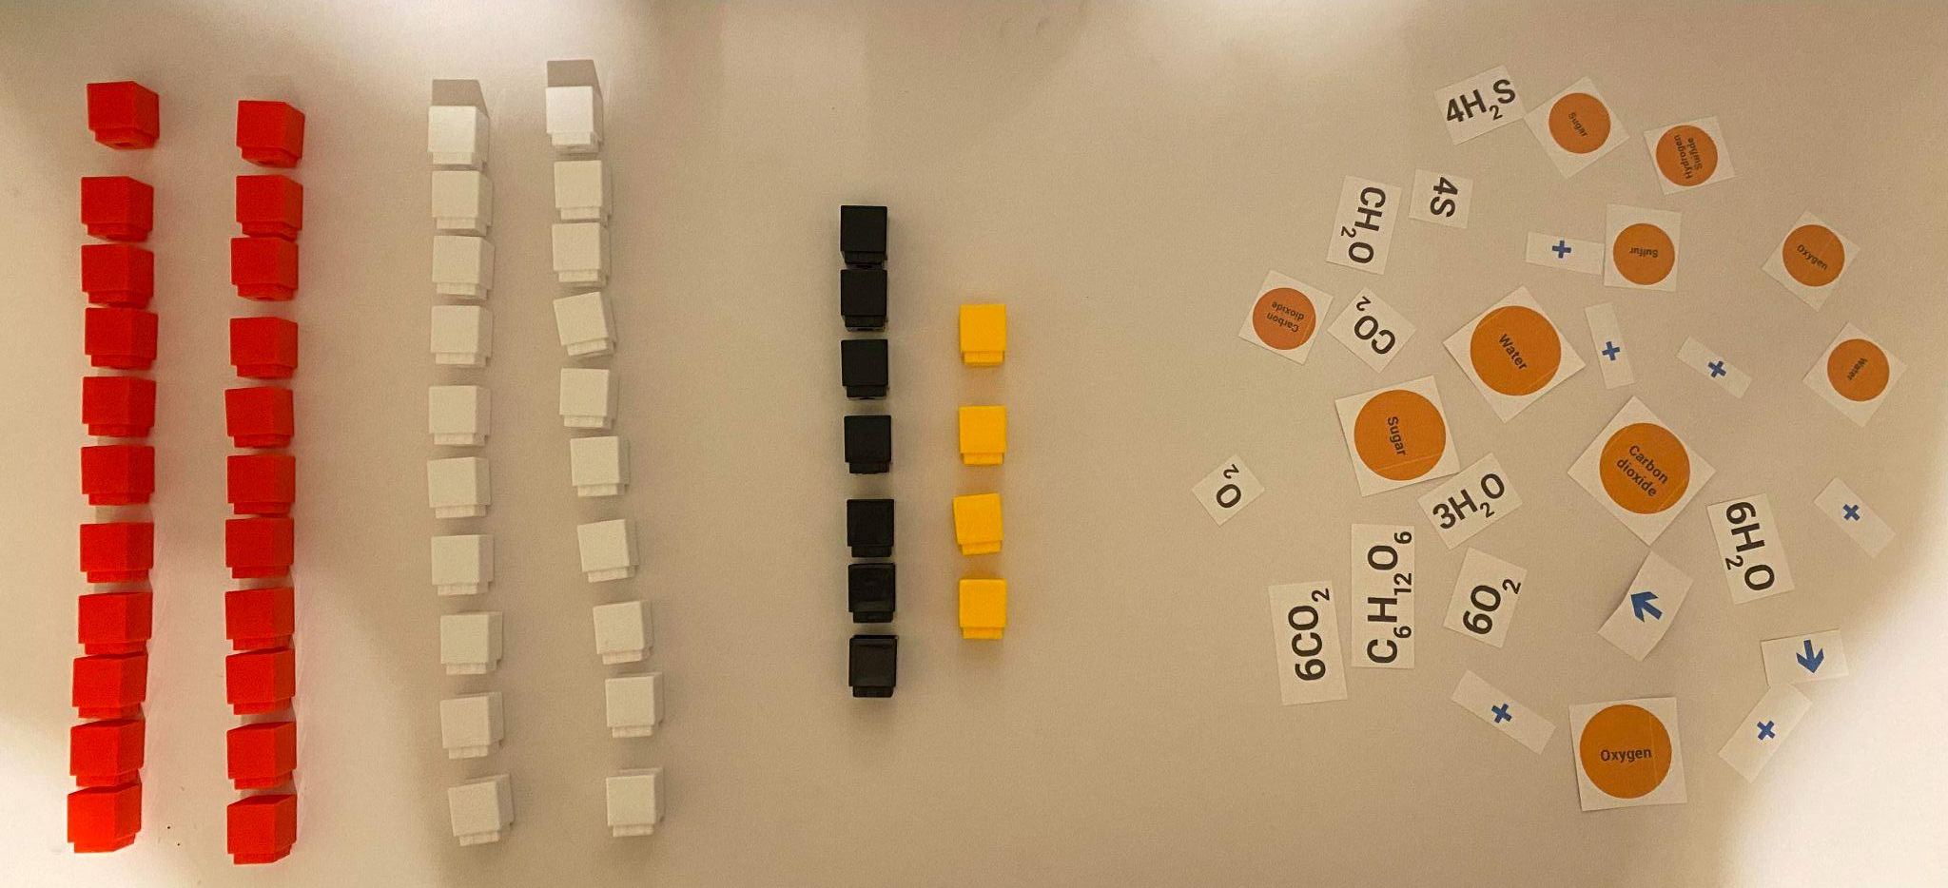
Learning Procedure - Modeling Materials
Learning Procedure - Modeling Materials
Example: Remember that colors may be different for your kit.
Each color block represents an atom.
Oxygen = 22
Hydrogen = 20
Carbon = 7
Sulfur = 4

Slide 9
Learning Procedure - Modeling Instructions
Learning Procedure - Modeling Instructions
Blocks in the bag represent the atoms for only the REACTANTS of each process.
The cut up equation pieces contain all the components for BOTH photosynthesis and one form of hydrothermal vent chemosynthesis.
Your group should start by putting together and labeling the reactants for photosynthesis.
  Hint: The remaining blocks should make the reactants for chemosynthesis.
Work as a team to try and figure out the correct equations for each process. Again, start with photosynthesis then go to chemosynthesis.

Slide 10
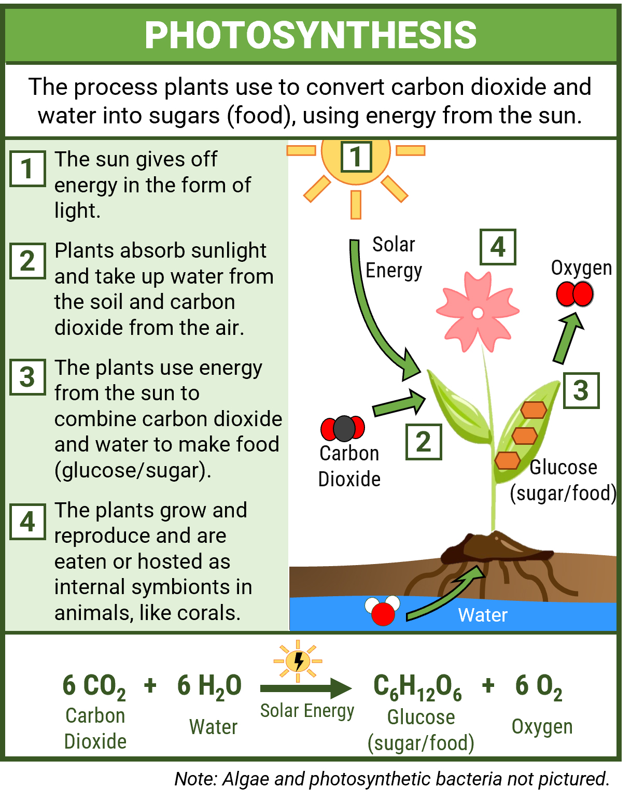
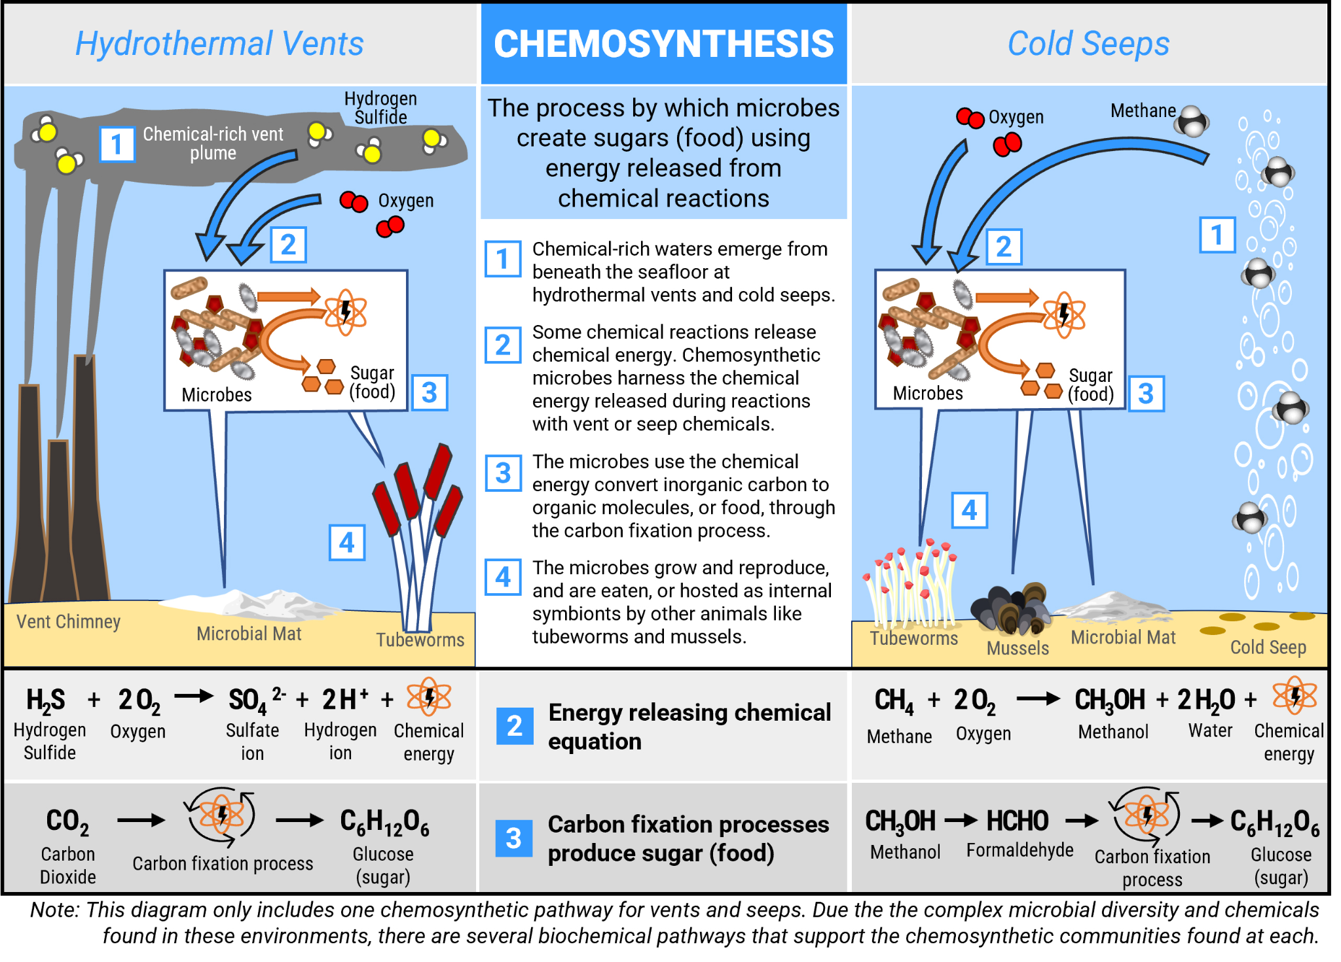
Chemosynthesis diagram

Slide 11
Learning Procedure: Compare and Contrast Processes
Photosynthesis | BOTH | Chemosynthesis
Write the equation. |  | Write the equation.

Slide 12
Learning Procedure
Learning Procedure
Notes:
VIDEO: https://oceanexplorer.noaa.gov/edu/multimedia-resources/dsd/media/hydrothermal-vents-1920x1080.mp4
Play 5:50-7:30 min

Slide 13
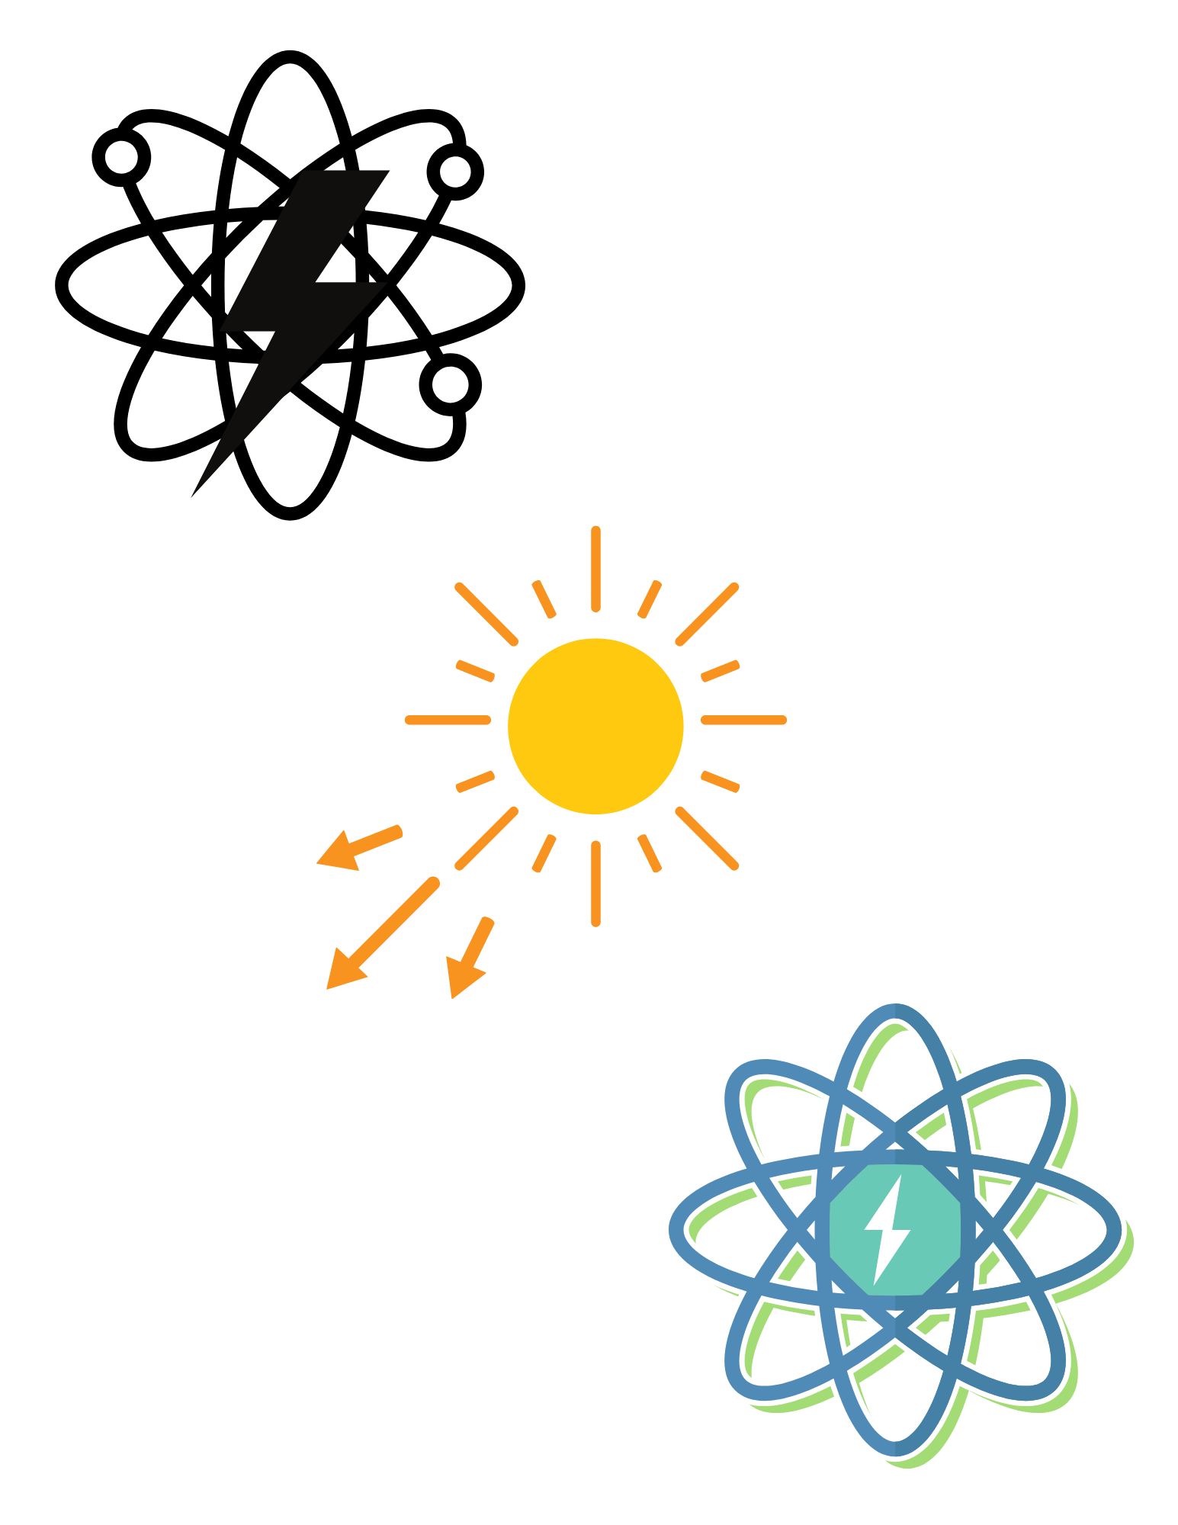
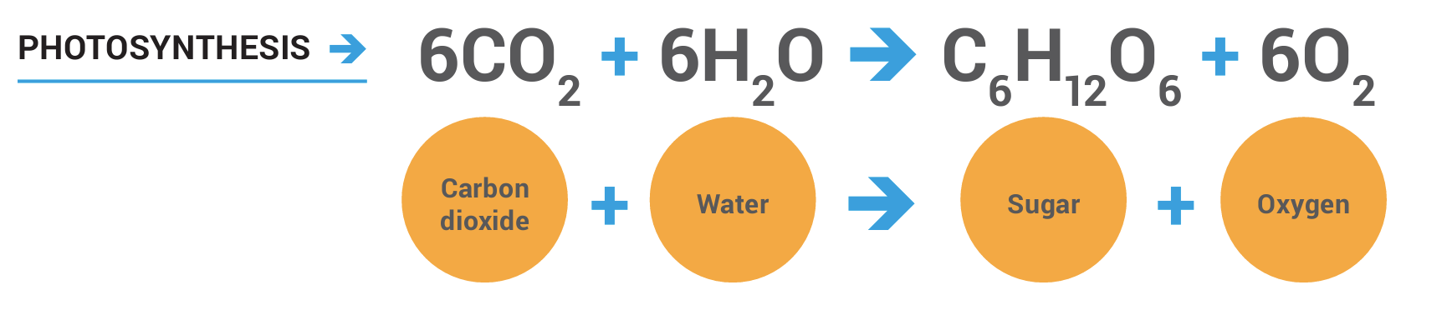
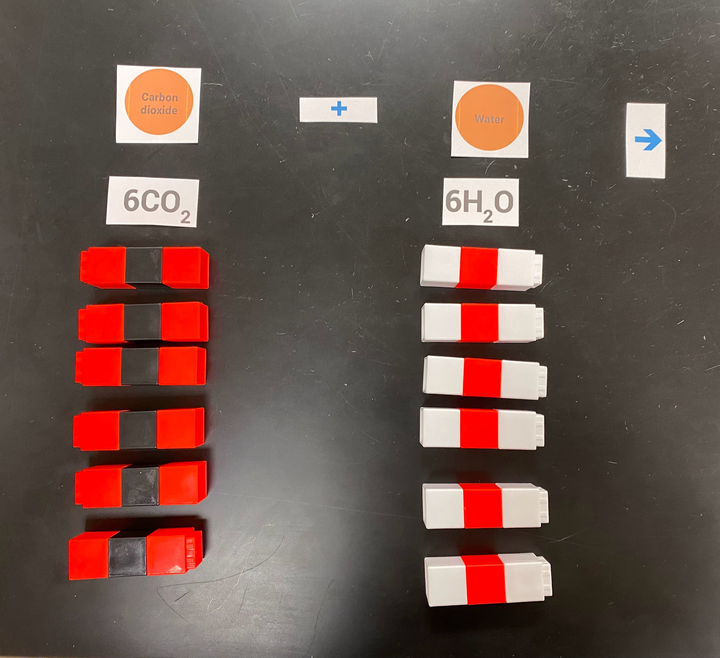
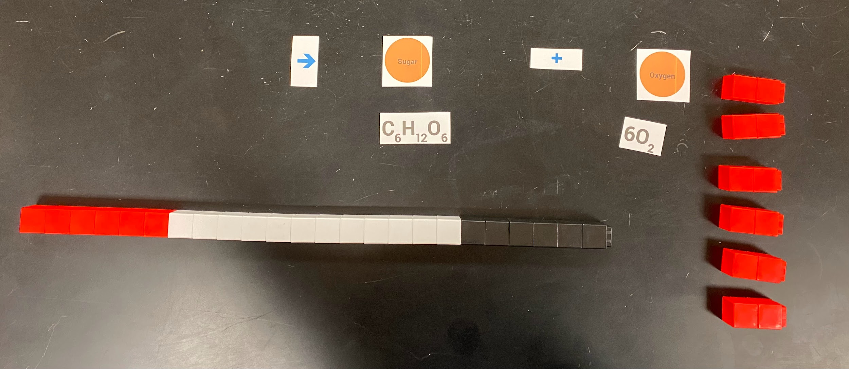
Chemical equation for photosynthesis

Slide 14
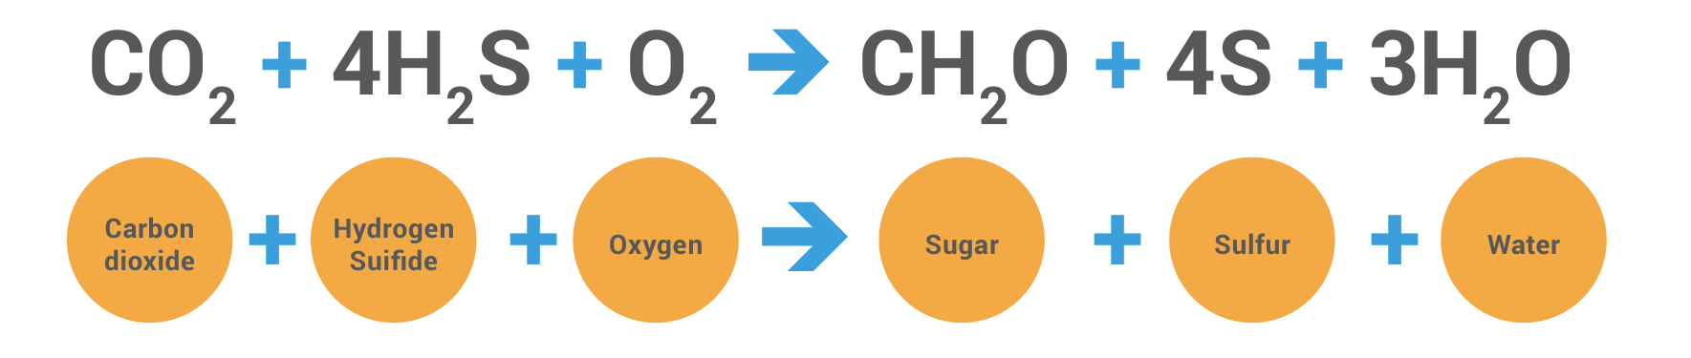
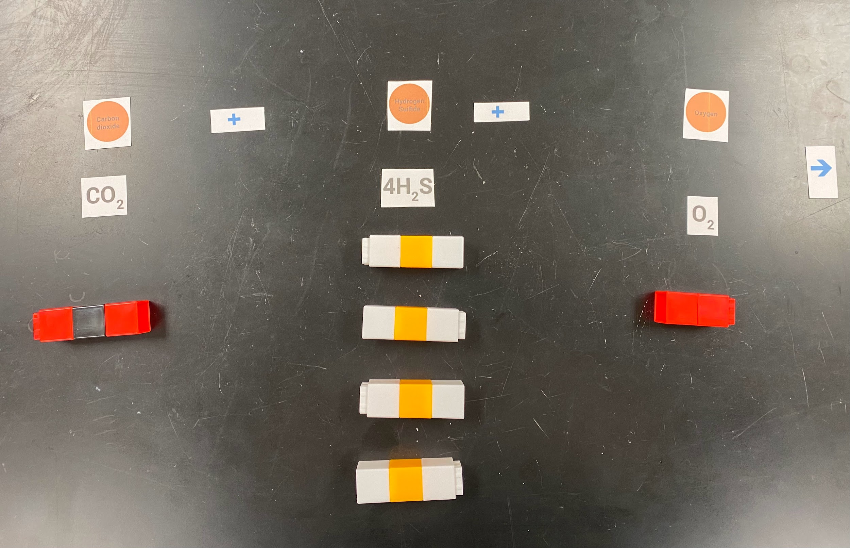
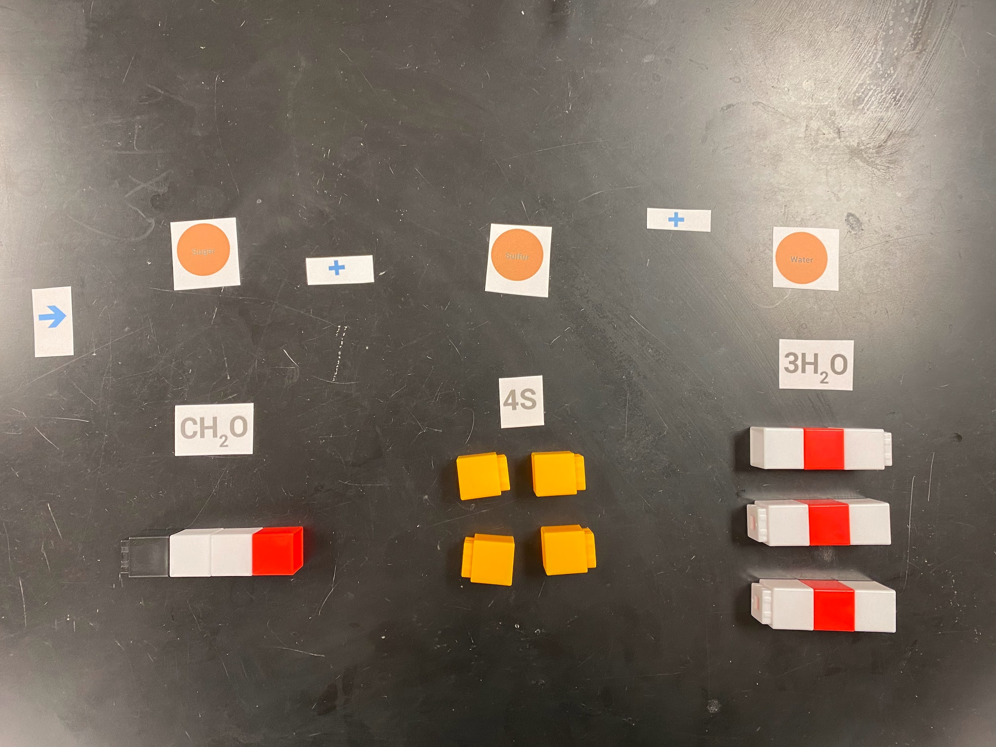
Illustration of chemosynthesis reaction components with chemical formulas and corresponding labels.

Slide 15
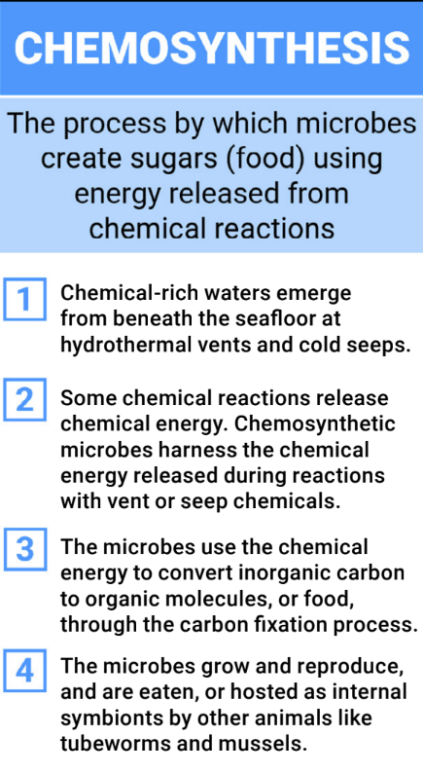
Putting the Pieces Together
Putting the Pieces Together
CO₂ + 4H₂S + O₂ CH₂O + 4S + 3H₂O

