Slide 1
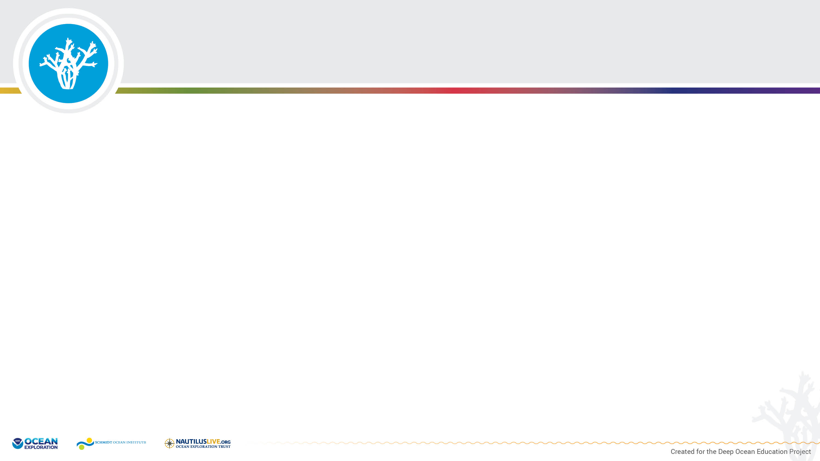
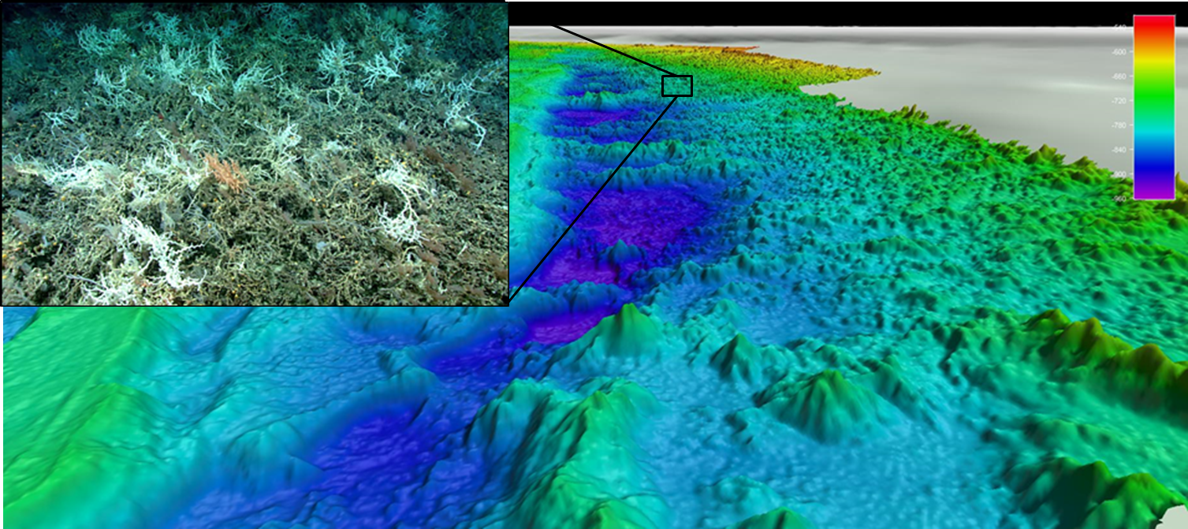
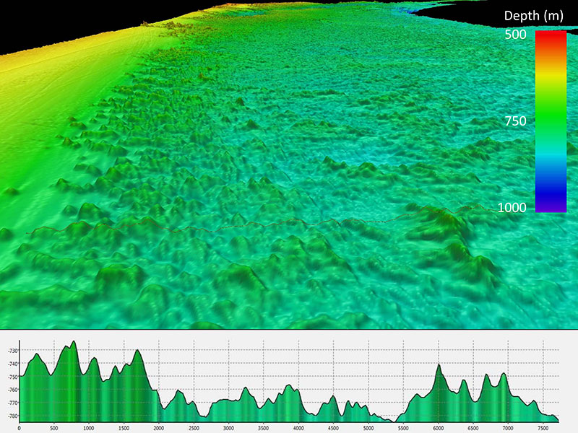
Million Mounds of Deep-Sea Coral
About a hundred miles off the coast of Georgia and Florida lies a strange ecosystem at the bottom of the sea. It’s an underwater landscape of coral mounds that stretch as far as the eye (or at least the camera on a remotely operated vehicle) can see. For thousands of years, corals have been growing and dying in this region that lies 600 to 800 meters (1,970 to 2,625 feet) below the ocean’s surface. This region provides important habitat, protection, and food for a variety of marine life. Now identified as one of the largest, continuous stretches of deep-sea corals on Earth (that we know of), and accessible only by submersible or autonomous vehicles, the “Million Mounds” region has drawn scientists to try to understand why do the corals live here?
Multibeam bathymetry data collected by NOAA Ship Okeanos Explorer showing the three-dimensional topography and profile of Million Mounds, and an image of the Lophelia coral habitat (top left).
Image courtesy of NOAA Ocean Exploration.

Slide 2
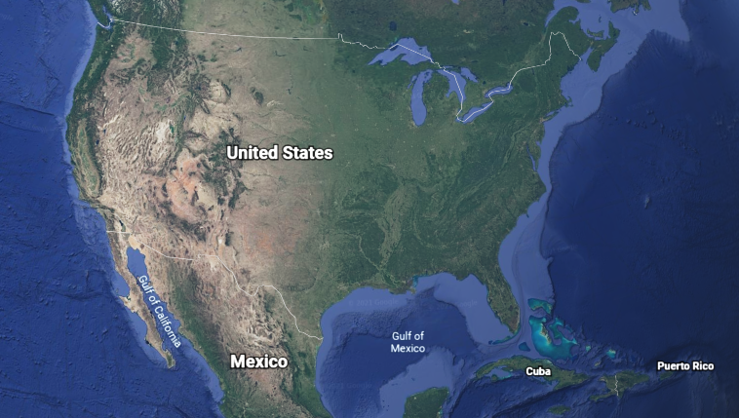
Million Mounds coral region

Slide 3
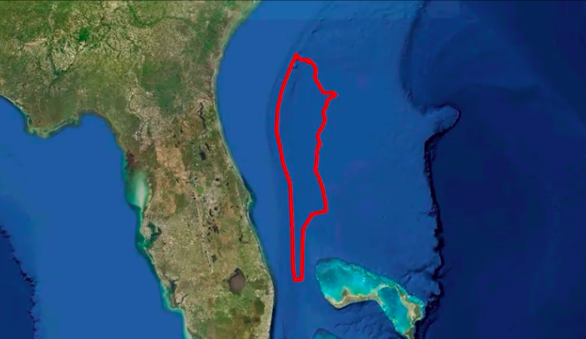
Million Mounds coral region
FLORIDA
Image credit: NOAA

Slide 4
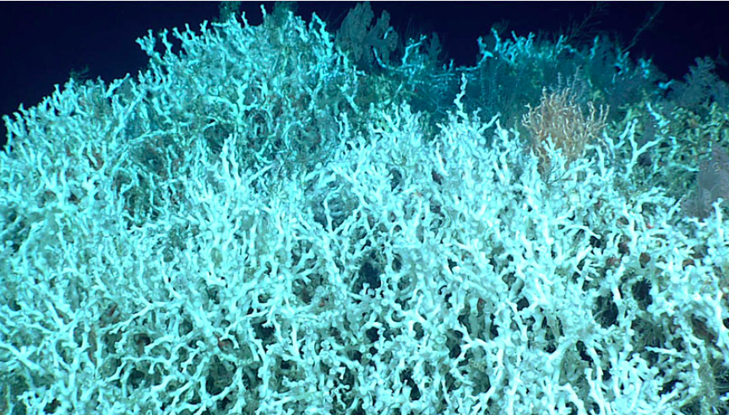
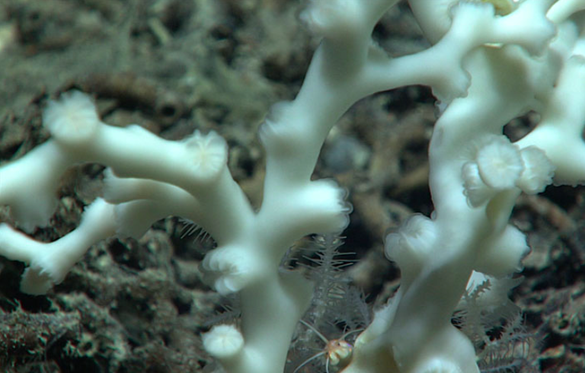
Lophelia pertusa
Deep-sea corals are animals.
The species of deep-sea coral we will focus on is Lophelia pertusa.
A colony of Lophelia pertusa is made up of thousands of individual polyps (animals).
Lophelia pertusa cannot move to another location (stationary/sessile).
Images courtesy of NOAA Ocean Exploration.

Slide 5
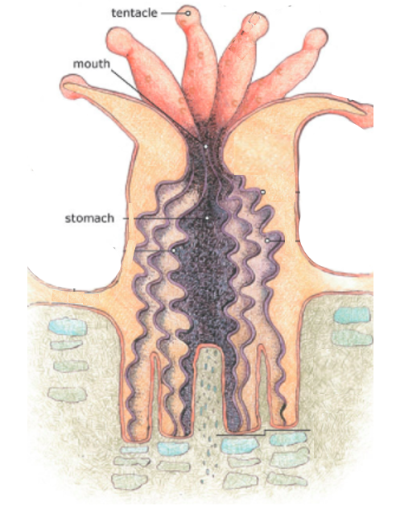
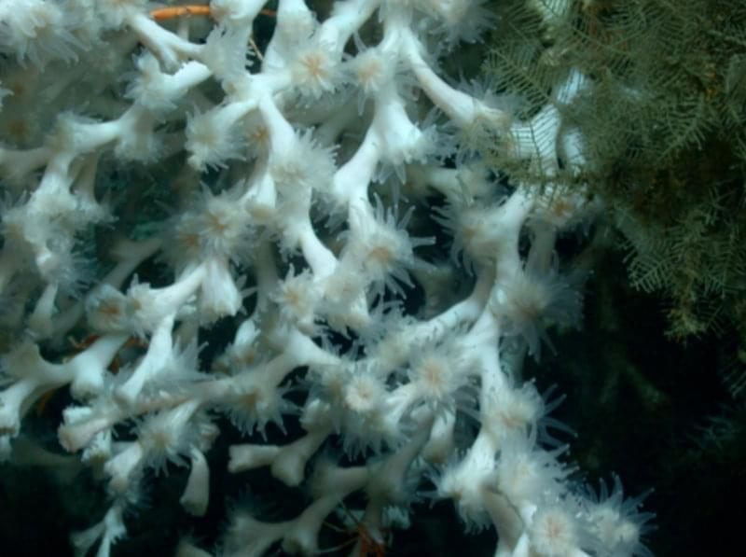
Lophelia pertusa
Image courtesy of NOAA Ocean Exploration.
Image courtesy of NOAA Coral Reef Conservation Program (adapted).

Slide 6
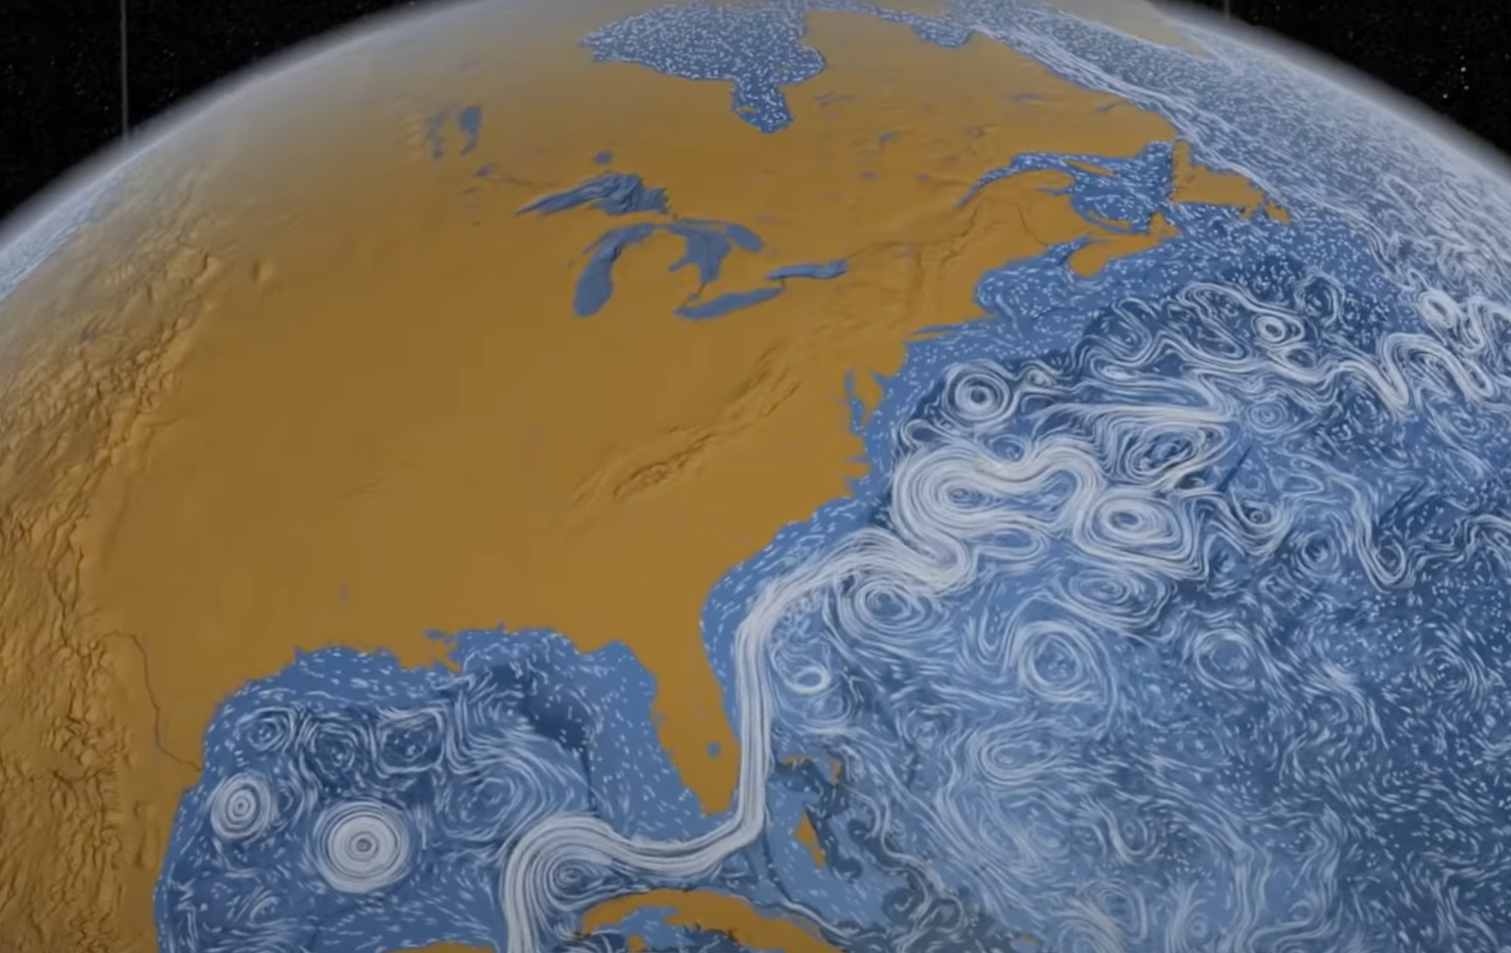
Surface Ocean Currents
Surface ocean currents off the United States East Coast and Gulf Coast. Image adapted from NASA Views our Perpetual Ocean animation, as seen in NOAA Making Waves: Episode 123 -Motion in the Ocean.
Original animation courtesy NASA/SVS. https://www.nasa.gov/topics/earth/features/perpetual-ocean.html
https://oceanservice.noaa.gov/podcast/apr14/mw123-currents.html

Slide 7
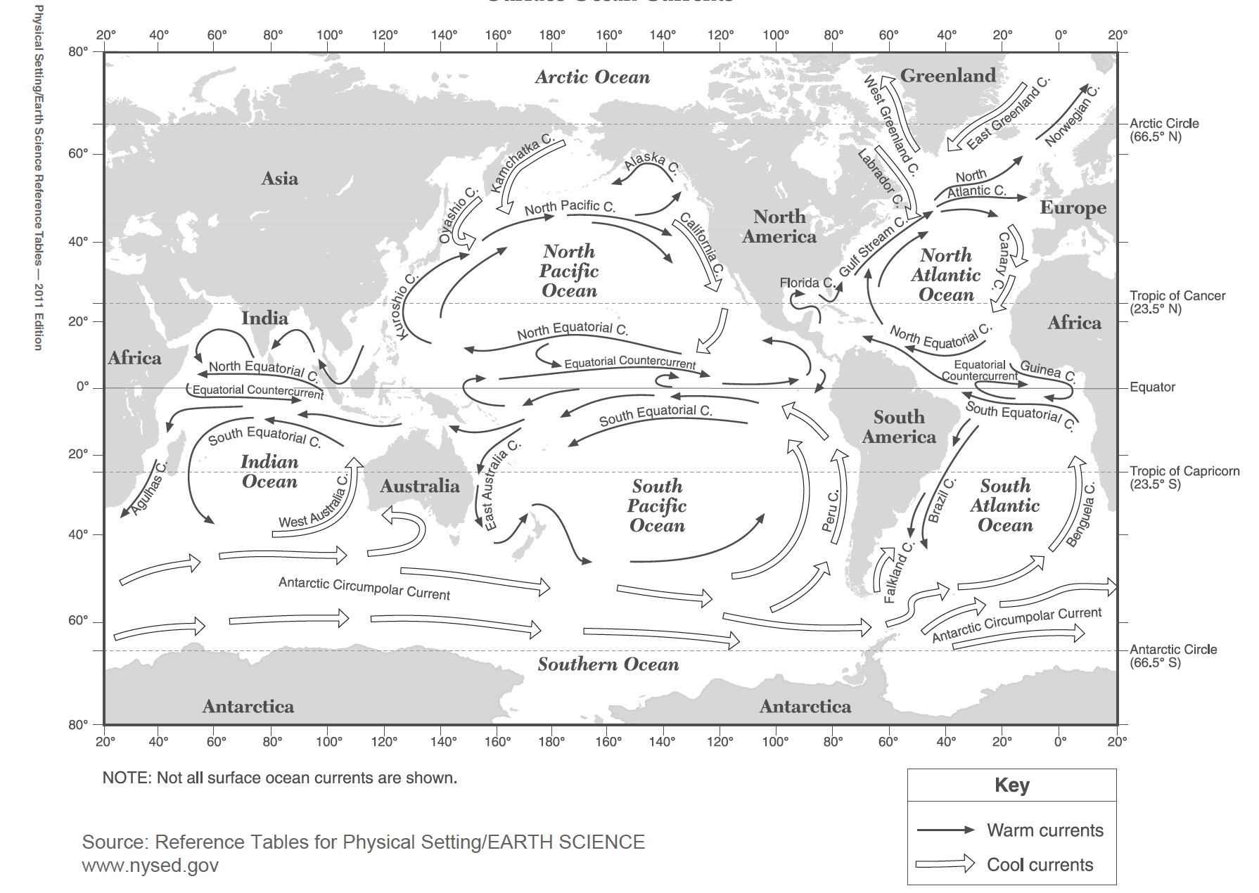
Global Surface Ocean Currents Map
KEY
Warm Water
Currents
Cool Water
Currents
*Note: Not all surface currents are shown.
Map of warm and cool water global surface ocean currents. Adapted from Reference Tables for Physical Setting/ Earth Science. www.nysed.gov

Slide 8
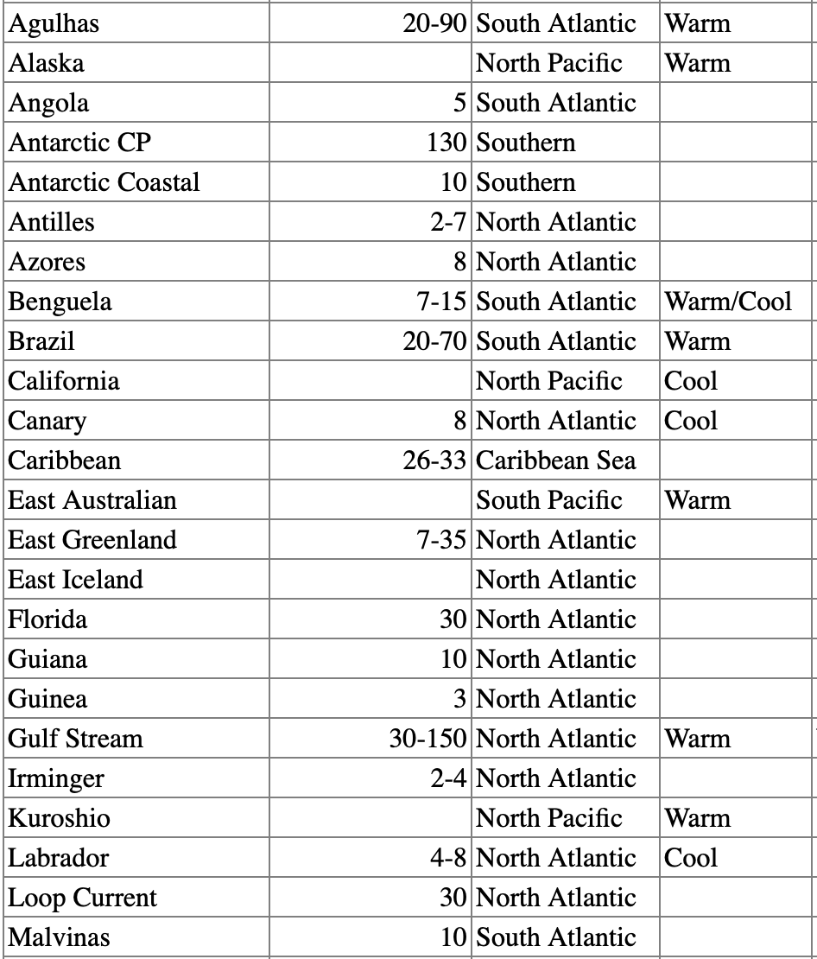
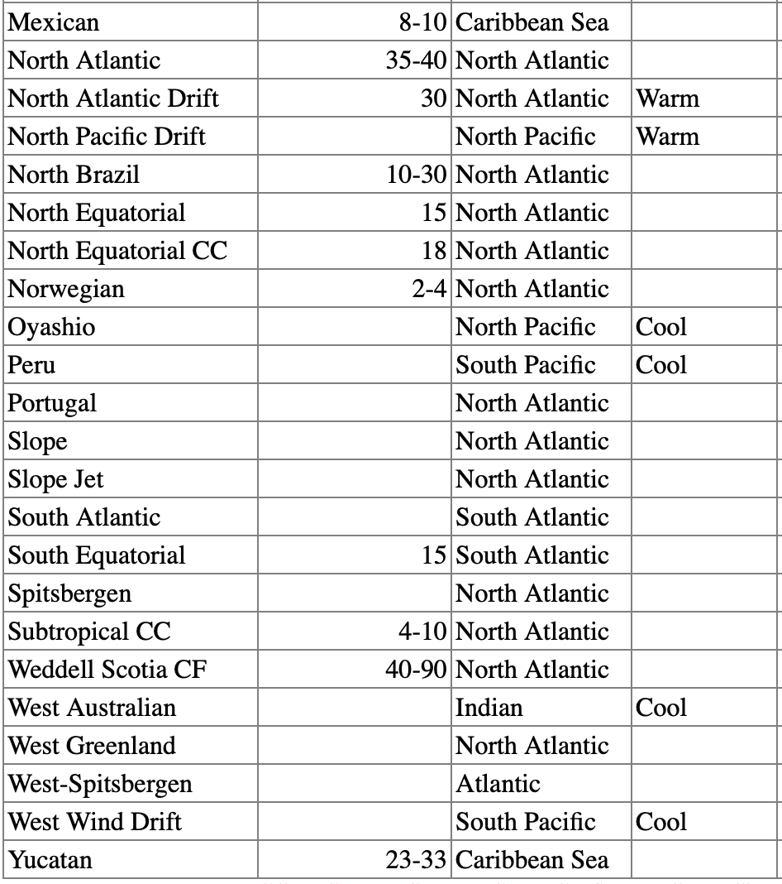
Global Ocean Surface Current Properties
Current Name | Transport Rate (Sv) | Ocean Basin | Type (Temp.)
Current Name | Transport Rate (Sv) | Ocean Basin | Type (Temp.)
CC = Counter Current
CF = Confluence
CP = Circumpolar
Sv = Sverdrup (the unit for volume of water flowing through an area)
1 Sv = 1 million cubic meters per second (106 m³/s)
Adapted from https://oceancurrents.rsmas.miami.edu/properties.html

Slide 9
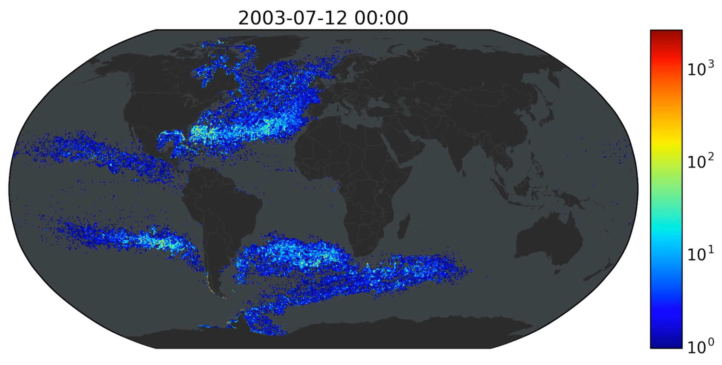
Ocean Currents move plankton - and pollution –
around the globe faster than thought
Princeton University researchers found that ocean currents can carry objects to almost any place on the globe in less than a decade, faster than previously thought. Pictured here is a still image captured from the Princeton model showing how phytoplankton traveling on ocean currents would spread over a three-year period. The researchers “released” thousands of particles representing phytoplankton and garbage from a starting point (green) stretching north to south from Greenland to the Antarctic Peninsula. The colors indicate low (blue) or high (red) concentration of particles. Over time, the particles spiral out to reach the North and South Pacific, Europe, Africa and the Indian Ocean.
View the whole model in action: https://player.vimeo.com/video/163414696
(Princeton University). Animation created by Bror Jönsson, Department of Geosciences.

Slide 10
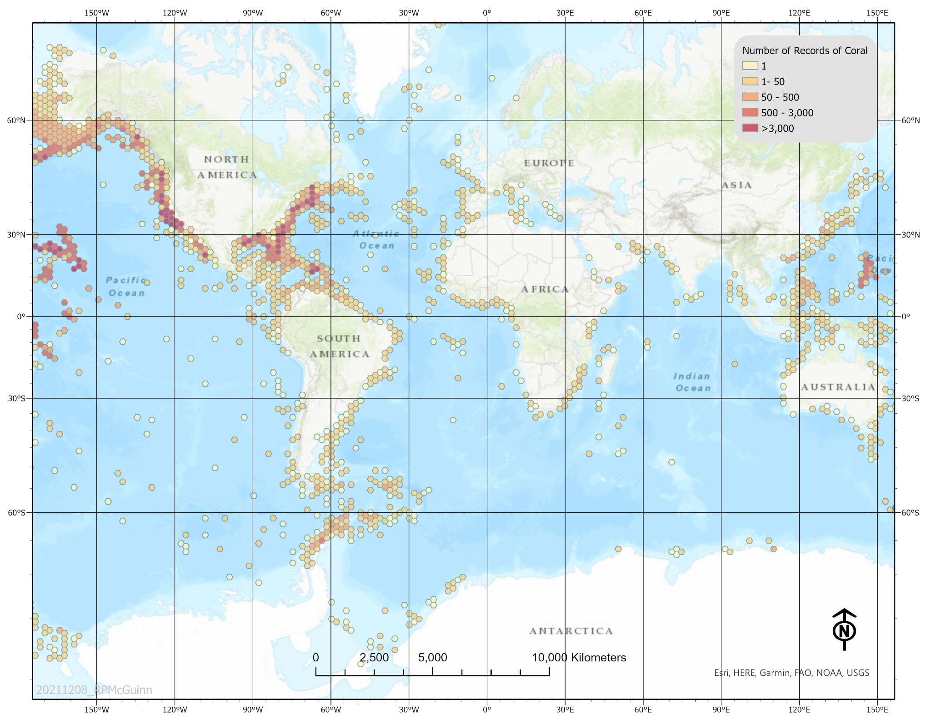
Global Deep-Sea Coral Observations Map
This map illustrates the known global distribution of deep-sea coral based on observations.
Hexagon bins represent the number of observations in a 240 square kilometer (93 square mile) area. Warmer colors (reds) represent high numbers of observations and cooler colors (yellows) represent fewer observations. *Note: These records indicate observations only. No observation does not mean that deep-sea corals are not present in that area. There is still a large portion of the ocean that has not been explored in detail.
Image courtesy of Robert McGuinn, NOAA Deep-Sea Coral Research and Technology Program.
https://oceanexplorer.noaa.gov/edu/materials/dsc-observations-map.jpg

