Slide 1
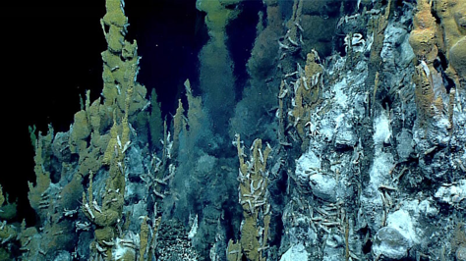
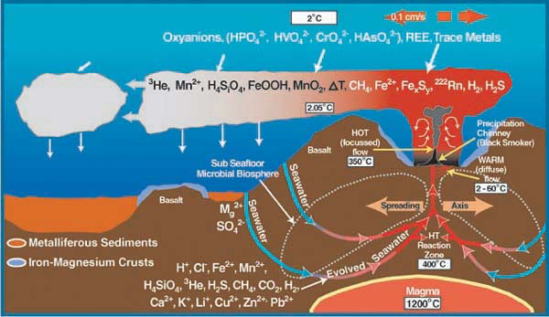
Introduction: Chemosynthesis at Hydrothermal Vents
The fluid that ‘vents’ out of the hydrothermal vent chimneys is rich in chemicals. As the seawater is heated by magma below the vent field, some chemicals are transferred to the water from the hot crust material. Some of these metals precipitate out of the fluid as it rises, forming the vent chimneys, while other minerals mix with surrounding waters.
Bacteria, or microbes, living on or around the hydrothermal vent use these chemicals for chemosynthesis, the process that makes food from inorganic compounds.
Vent chemicals for chemosynthesis:
Vent image: Courtesy of the NOAA Ocean Exploration, 2016 Deepwater Exploration of the Marianas.
Vent diagram: Image modified from Massoth et al., 1988; courtesy of Submarine Ring of Fire 2002, NOAA Ocean Exploration.

Slide 2
Activity Instructions (digital version, option 1)
Read through the following organism cards to learn more about several of the organisms that make up a hydrothermal vent community.
Using the information on the cards, create a food chain that includes four of the organism cards.
Drag four of the organism cards on slide 17 to form a food chain (move the extra cards off to the side by dragging them out of the way).
Hint: You should end up with one organism in each trophic level on slide 19.
Draw arrows between the organism cards to show the direction that energy is flowing through the food chain.
Hydrothermal vent food webs are far more complex than a simple food chain. Now, use all of the organism cards to complete the food web template on slide 18.
Type the name of each organism in the empty boxes provided.
Draw arrows to show the direction that energy is flowing through the food web.
Hint: Some organisms will eat or be eaten by more than one organism!

Slide 3
Activity Instructions (digital version, option 2)
Read through the following organism cards to learn more about several of the organisms that make up a hydrothermal vent community.
Using the information on the cards, create a food chain that includes four of the organism cards on slide 17.
Copy the four organisms you wish to use from slide 17 and paste onto slide 19.
Arrange the organism cards to form a food chain.
Hint: You should end up with one organism in each trophic level on slide 19.
Draw arrows between the organism cards to show the direction that energy is flowing through the food chain.
Hydrothermal vent food webs are far more complex than a simple food chain. Now, use all of the organism cards on slide 17 to create a food web.
Copy all of the organism cards from slide 17 and paste onto slide 19.
Arrange the organism cards by dragging them into the appropriate trophic levels on slide 19 to form a food web.
Draw arrows between the organism cards to show the direction that energy is flowing through the food chain.
Hint: Some organisms will eat or be eaten by more than one other organism!

Slide 4
Hydrothermal Vent Chemicals
H₂S
Hydrogen Sulfide
O₂
Oxygen
CO₂
Carbon Dioxide
CH₄
Methane

Slide 5
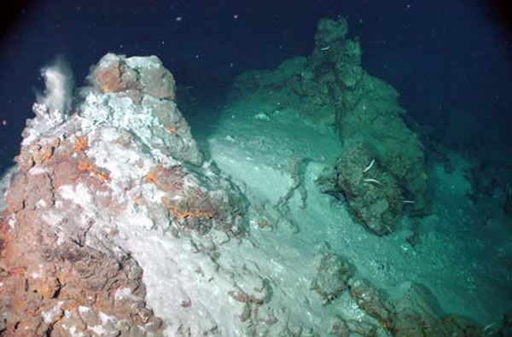
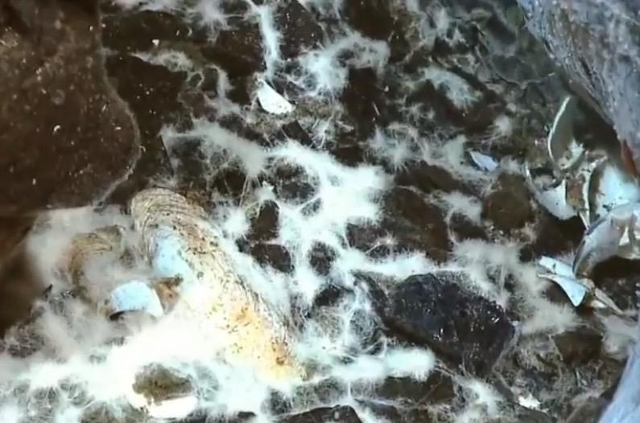
Vent Bacteria, Arcobacter sulfidicus
These free-swimming microbes have four long flagella (tails) that help propel them through the water. These bacteria are also able to form bacterial mats that appear stringy or wispy in texture.
The bacteria are chemosynthetic. They oxidize hydrogen sulfide, add carbon dioxide and oxygen to produce sugar (food), sulfur, and water. The food that chemosynthetic bacteria produce serves as the base of the hydrothermal vent food web.
Top: Image courtesy of Submarine Ring of Fire 2002, NOAA Ocean Exploration.
Bottom: Image adapted from “New Vent Site” video. Courtesy of NOAA Ocean Exploration, Galapágos Rift Expedition 2011.

Slide 6
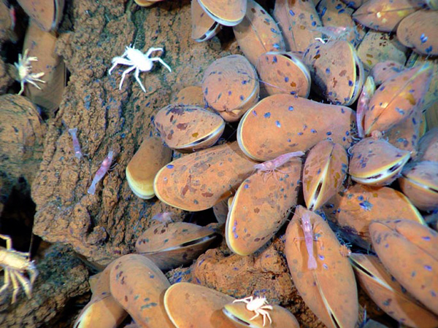
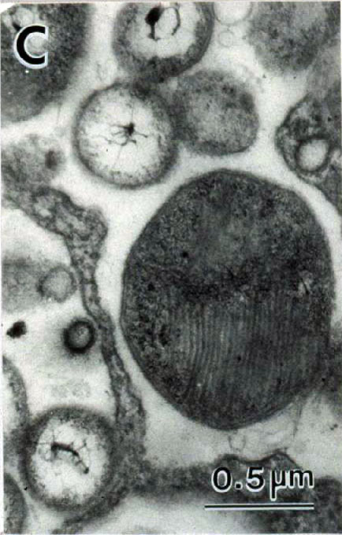
Symbiotic Bacteria
Symbiotic vent bacteria are found inside the tissues of other vent animals, such as tubeworms or mussels.
The bacteria are chemosynthetic. They oxidize hydrogen sulfide, add carbon dioxide and oxygen to produce sugar (food), sulfur, and water. The food that chemosynthetic bacteria produce serves as the base of the hydrothermal vent food web.
The food the bacteria makes is shared with the host organism, and in return the bacteria has a safe home.
The image to the left shows two symbiotic microbes found living inside the tissues of vent mussels.
Mussels: Image courtesy of Submarine Ring of Fire 2004, NOAA Vents Program.
Bacteria: Image courtesy of Fisher et. al, Marine Ecology 1993.

Slide 7
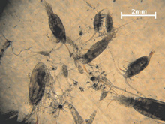
Vent Zooplankton
Zooplankton are microscopic animals that drift in the ocean. At hydrothermal vents, they usually include the larval forms of several species found near vents, like crabs, shrimp, worms and snails.
These larval forms may drift in the water column for days to months before settling back to the bottom, and are the main means by which new vent sites are colonized.
Here, zooplankton consume bacteria living at the vents.
Image courtesy of Submarine Ring of Fire 2014 - Ironman, NOAA/PMEL.

Slide 8
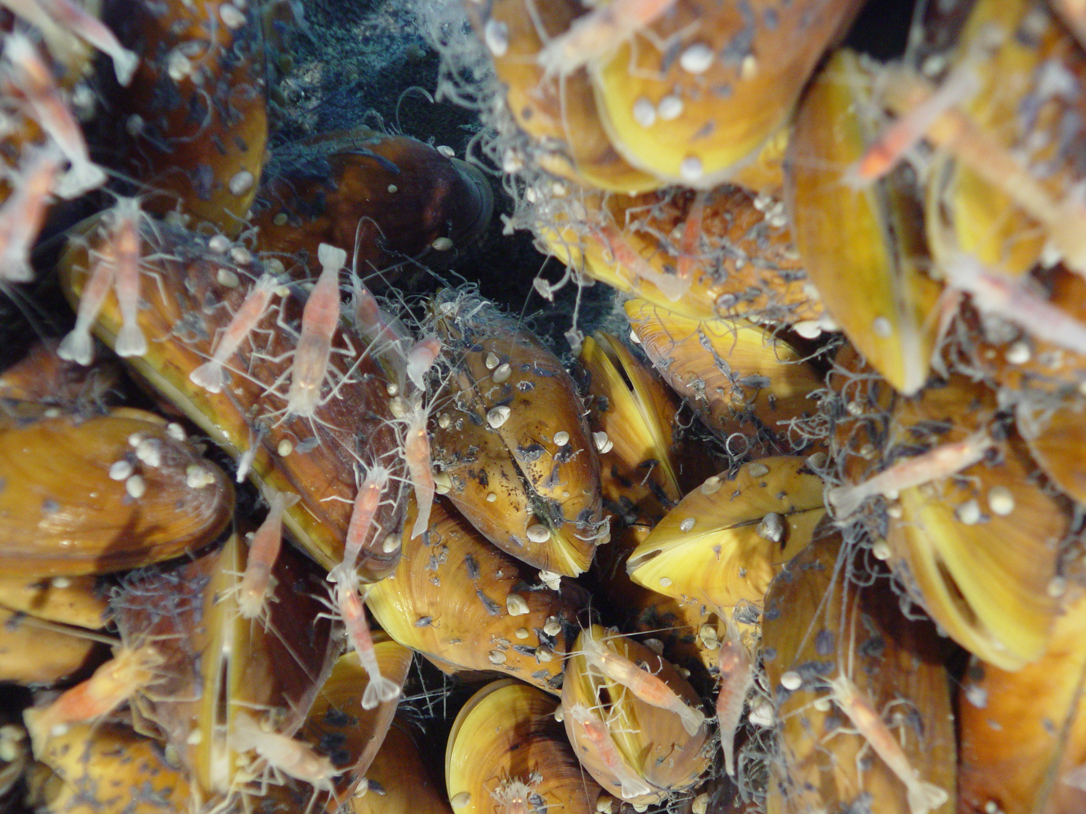
Vent Shrimp
These small shrimp are well adapted for living in the extreme conditions of a hydrothermal vent. They are capable of surviving very high temperatures.
Some species are blind. Instead of eyes, these species have specialized heat sensing organs on their backs that help them “see” the surrounding environment.
Some species of vent shrimp feed directly on the bacterial mats growing on and around vent chimneys for their entire life, while others only feed on the bacteria during early life stages.
Image courtesy of Submarine Ring of Fire 2014 - Ironman, NOAA/PMEL.

Slide 9
Vent Mussel, Bathymodiolus sp.
Vent mussels attach to vent chimneys and surrounding rocks using byssal threads, or very sticky filaments produced by the mussels’ foot.
The mussels are often found growing in large clusters. The black spots on the shells are former anchor points of mussels who have cut their threads and moved on.
The small gaps between mussels in a cluster are used by other small vent invertebrates like worms or shrimp.
Vent mussels have chemosynthetic bacteria that live inside their gills. The bacteria make food for the mussels by converting inorganic materials into sugars. They are also capable of suspension feeding.
Some species of mussels have more than one type of symbiont in their gills, allowing them to derive energy from different inorganic compounds, such as methane or hydrogen sulfide.
Image courtesy of Submarine Ring of Fire 2004, NOAA Vents Program.

Slide 10
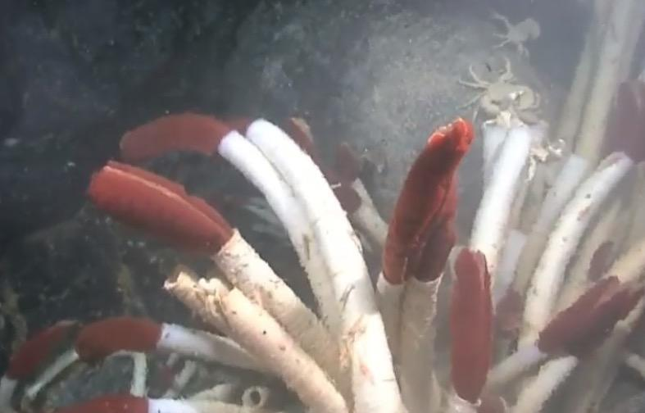
Riftia Tubeworm, Riftia pachptyla
Tubeworms do not have a mouth, gut, or anus. They completely lack a digestive system!
Instead of "eating," these animals get their food from special symbiotic bacteria that live within their body in an organ called the trophosome. It is estimated that one tubeworm is host to billions of these chemosynthetic bacteria.
The white tube acts as the outer skeleton for the worm. This can grow over 1 meter (3 feet) in length.
The red plume is bright red in color due to high blood flow. The blood carries important compounds from the water, like oxygen, to the symbionts living inside.
The image to the left appears blurry due to the extremely hot water “venting” out of the vent field, which distorts the image.
Image adapted from “New Vent Site” video. Courtesy of NOAA Ocean Exploration, Galapágos Rift Expedition 2011.

Slide 11
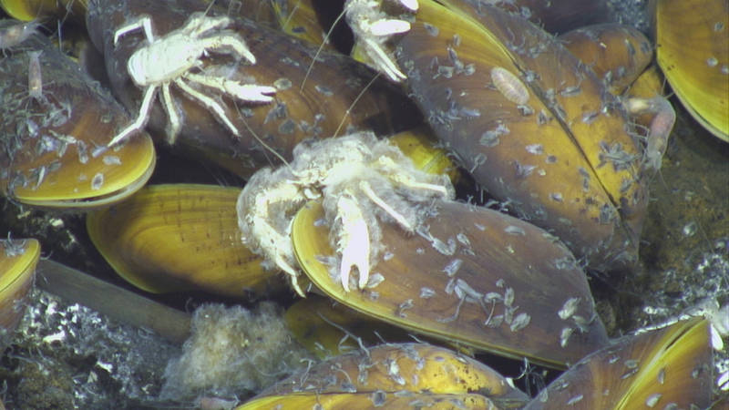
Squat Lobsters (Galatheid Crabs), Munidopsis alvisca
Squat lobsters are small crustaceans that roam about the vent ecosystem. They have very long claws. Some species have claws twice as long as their body.
The squat lobsters in this photo appear “hairy” due to the bacteria growing on their shells.
They are scavengers that feed on bacteria mats, small zooplankton, amphipods, and other vent debris.
Image courtesy of Submarine Ring of Fire 2014 - Ironman, NSF, NOAA, Jason, copyright WHOI.

Slide 12
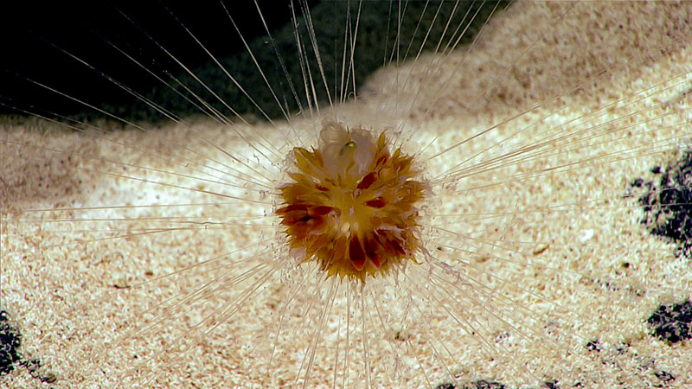
Dandelion Siphonophore
Siphonophores are actually comprised of many individuals that all work together. Some individuals protect the colony, some catch food, and some reproduce. They are a type of cnidarian, closely related to corals, sea anemones, and jellyfish.
Dandelion siphonophores are usually observed anchored to seafloor using their tentacles. This animal was observed at approximately 2,530 meters (8,300 feet) depth, with its feeding tentacles extended around the animal like a spider web. All siphonophores are predatory carnivores believed to feed on copepods, and other small crustaceans like crabs and krill.
Image courtesy of the NOAA Ocean Exploration, 2017 Laulima O Ka Moana.

Slide 13
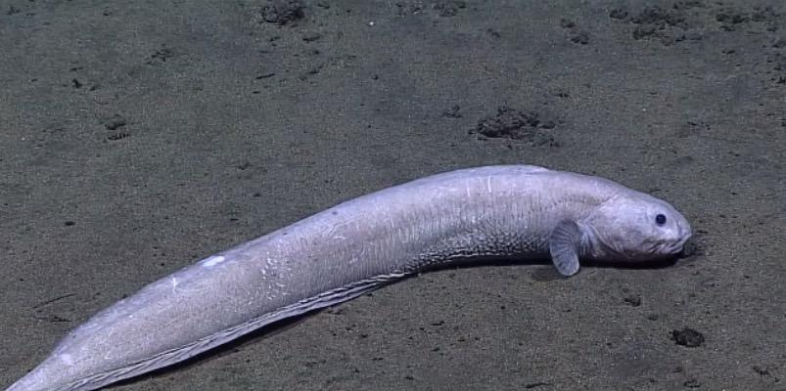
Eelpout (Zoarcid Fish), Pachycara gymninium
These long, slender white fish grow up to two feet (61 centimeters) in length. They are quite slow and lethargic. They spend a lot of time floating around clumps of tubeworms and mussels.
Despite their sluggish behavior, they have huge appetites. Eelpouts are predators that feed on everything from tubeworms to shrimp.
Image adapted from “New Fish Species” video. Courtesy of NOAA Ocean Exploration, 2016 Deepwater Exploration of the Marianas.

Slide 14
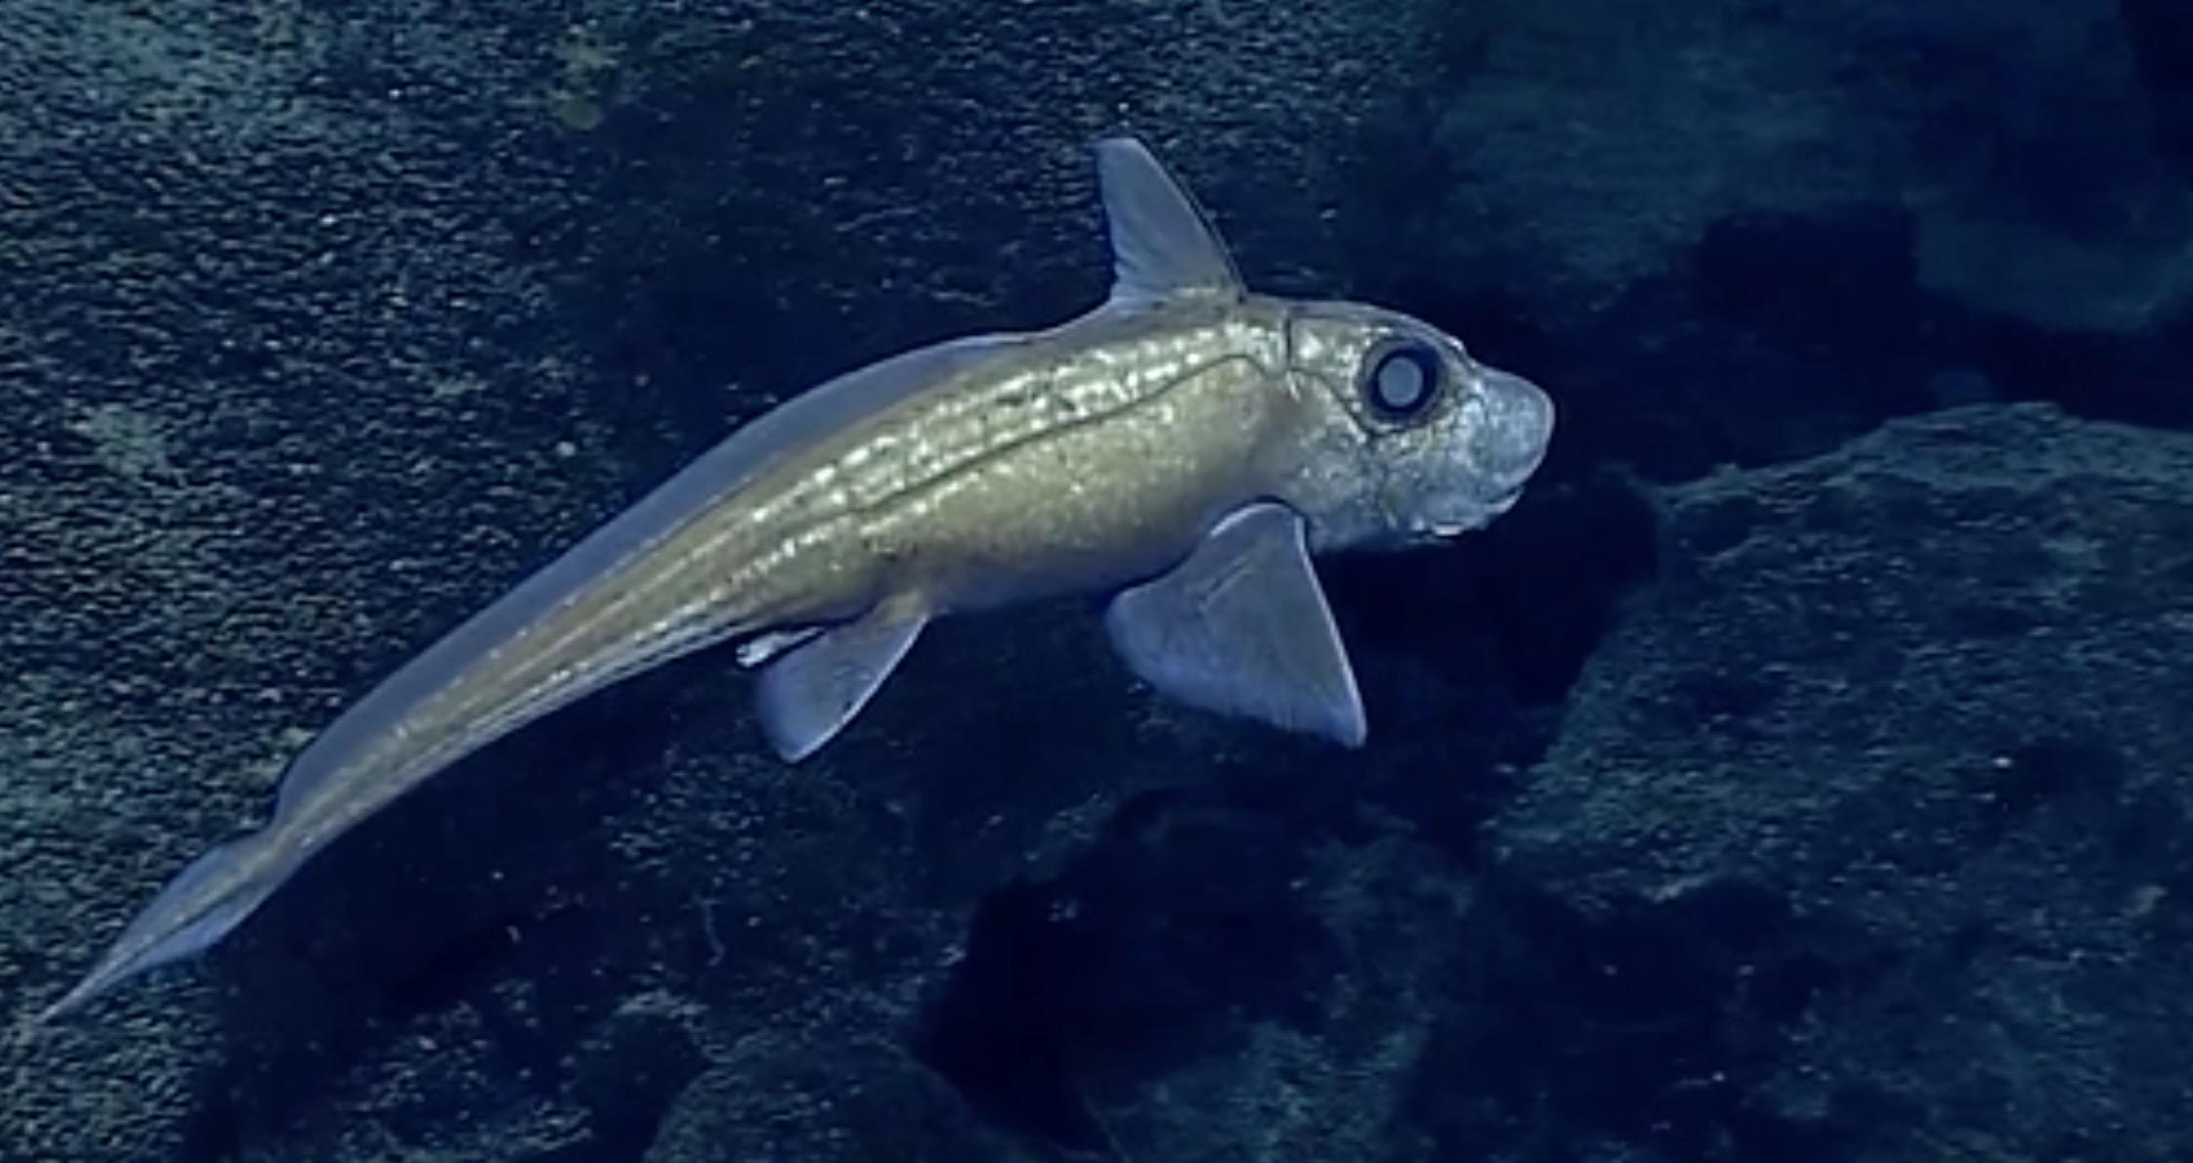
Vent Ratfish (Chimaera), Hydrolagus affinis
Ratfish, also known as a chimaera, have long, tapered tails and short, rounded snouts.
Like sharks, ratfish are cartilaginous, and have no real bones. The prominent lateral line that runs down their side is full of mechanoreceptors that detect pressure waves, similar to human ears.
The vent ratfish is a carnivore and feeds on a variety of animals smaller than itself. It eats crabs, shrimp, smaller fish, and vent mussels.
Image adapted from “Chimaera” video. Courtesy of NOAA Ocean Exploration, 2016 Deepwater Exploration of the Marianas.

Slide 15
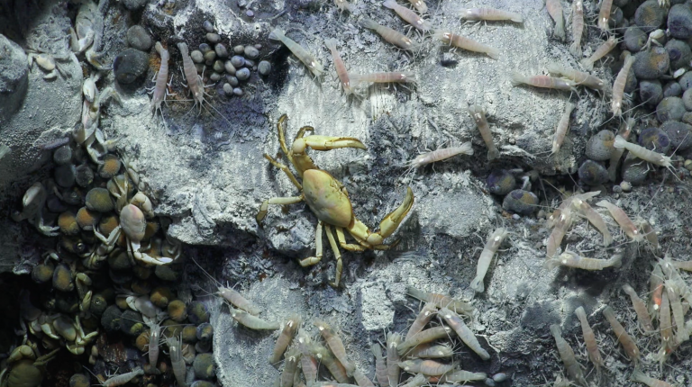
Blind Crab
Crabs are scavengers and these blind vent crabs are known to feed on shrimp, mussels, tubeworms as well as each other.
Image courtesy of Schmidt Ocean Institute

Slide 16
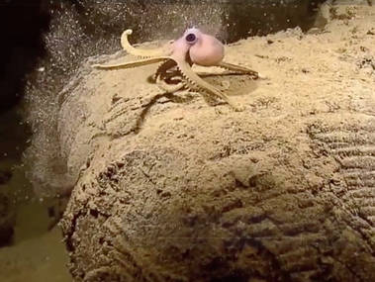
Octopus
Octopods are very active, carnivorous molluscs. They have eight arms lined with suction cups that help them catch prey and they hide in small crevices around the vents.
Certain species of octopods eat many smaller animals in the vent ecosystem such as crabs, shrimp, and mussels.
Image adapted from “Octopus” video. Courtesy of NOAA Ocean Exploration, Galapágos Rift Expedition 2011.

Slide 17
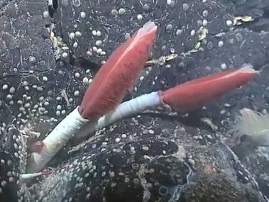
Hydrothermal Vents: Organism Cards
Blind Crab
Riftia Tubeworm
H₂S C0₂
0₂ CH₄
Vent Chemicals
Symbiotic Bacteria
Eelpout
Zooplankton
Squat Lobster
Ratfish
Vent Bacteria
Vent Shrimp
Octopus
Dandelion Siphonophore
Vent Mussel
17

Slide 18
Hydrothermal Vent: Food Web
(Option 1)
Read through the organism cards above. Fill in the hydrothermal vent food web below by typing in the organism’s name where it belongs. Draw arrows between the organisms to show what direction the energy flows through the food web and “who eats who.”
Simple Chemicals
Primary Producers
Primary Consumers
First Order Carnivores
Top Order Carnivores
H₂S
C0₂
0₂
CH₄

Slide 19
Hydrothermal Vent: Food Web
(Option 2)
Read through the organism cards above. Copy and paste the organism cards on slide 17 below. Create a food web by arranging the organism cards into the categories below. Draw arrows between the organisms to show what direction the energy flows through the food web and “who eats who.”
Simple Chemicals
Primary Producers
Primary Consumers
First Order Carnivores
Top Order Carnivores
H₂S
C0₂
0₂
CH₄

Slide 20
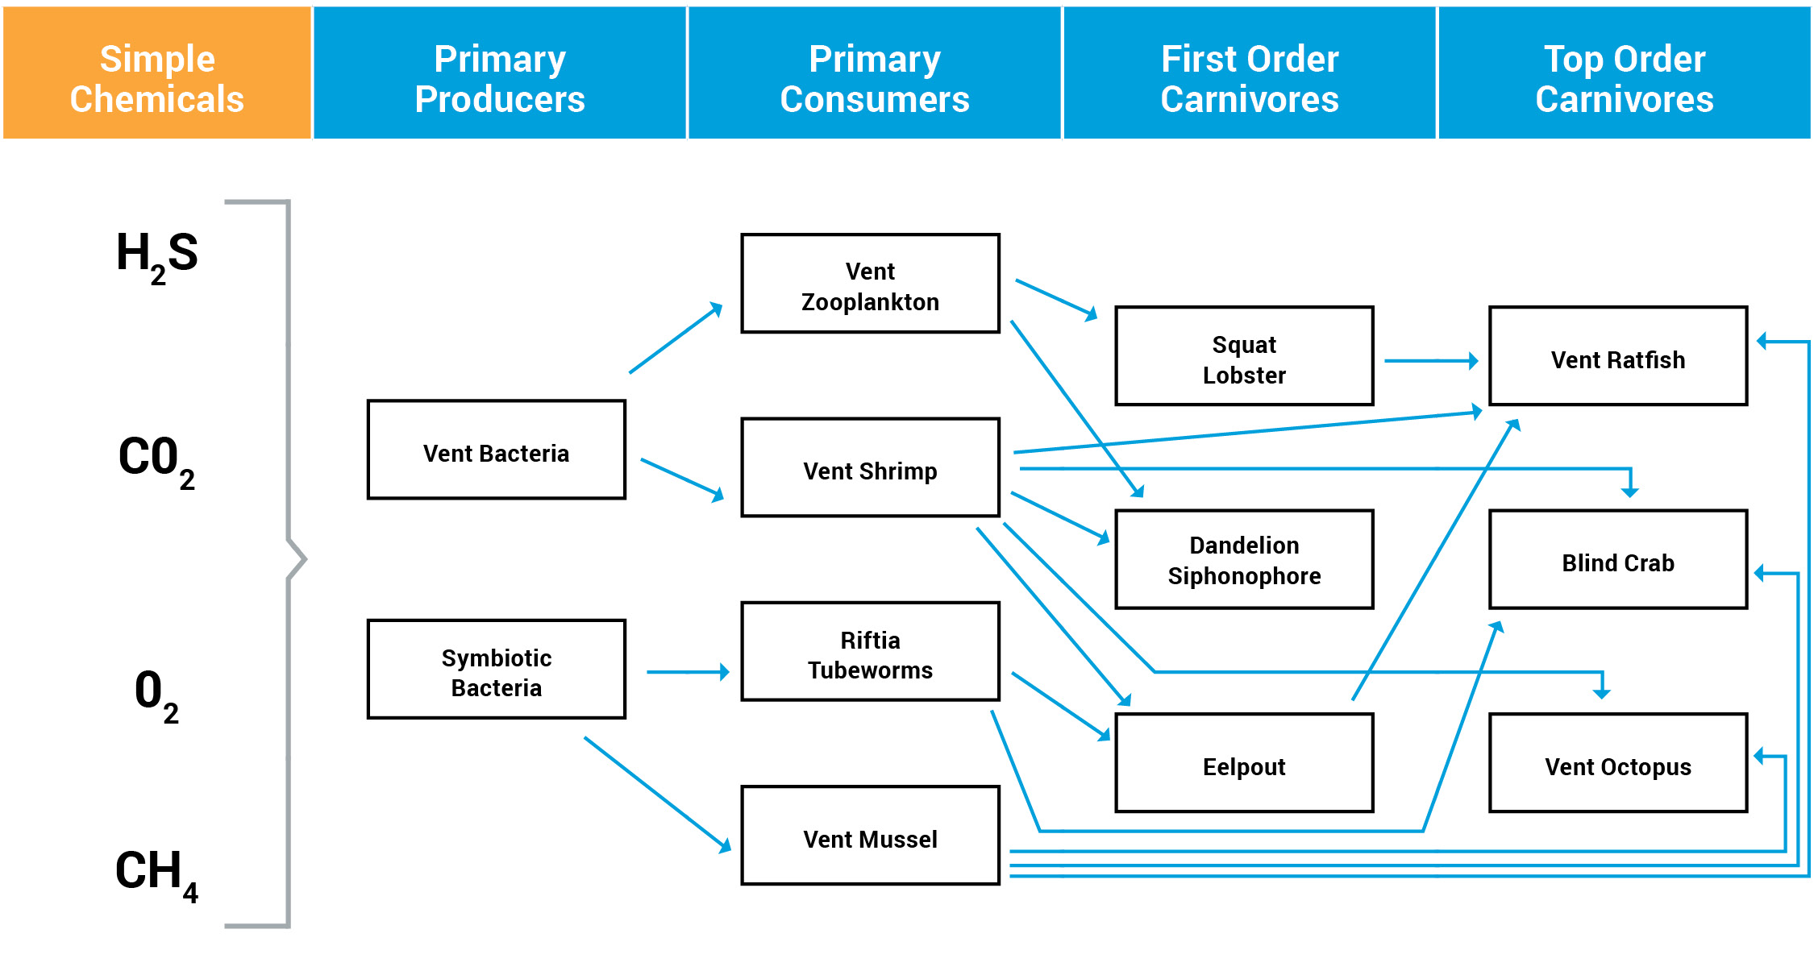
Hydrothermal Vent: Food Web (Answer Key)

Slide 21
Image Hyperlinks
SLIDE 2 Vent: https://oceanexplorer.noaa.gov/okeanos/explorations/ex1605/logs/photolog/welcome.html#cbpi=/okeanos/explorations/ex1605/dailyupdates/media/may2.html
Diagram: https://oceanexplorer.noaa.gov/explorations/02fire/background/vent_chem/media/chemistry.html
SLIDE 5 (Vent Bacteria)
Top: https://oceanexplorer.noaa.gov/explorations/02fire/logs/jul29/media/anhydrite.html
Bottom: https://oceanexplorer.noaa.gov/okeanos/explorations/ex1103/logs/photolog/welcome.html#cbpi=/okeanos/explorations/ex1103/dailyupdates/media/video/0723-vent-site.html
SLIDE 6 (Symbiotic Bacteria)
Mussels: https://oceanexplorer.noaa.gov/explorations/04fire/logs/april11/media/grazers_600.jpg
Bacteria: https://oceanexplorer.noaa.gov/explorations/06mexico/logs/may20/may20.html
SLIDE 7 (Vent Zooplankton): https://oceanexplorer.noaa.gov/explorations/04fire/logs/april14/april14.html
SLIDE 8 (Vent Shrimp): https://oceanexplorer.noaa.gov/explorations/14fire/background/seamounts/media/eifuku_mussels4_hires.jpg
SLIDE 9 (Vent Mussel): https://oceanexplorer.noaa.gov/explorations/04fire/logs/april11/media/grazers_600.jpg
SLIDE 10 (Riftia Tubeworm): https://oceanexplorer.noaa.gov/okeanos/explorations/ex1103/logs/photolog/welcome.html#cbpi=/okeanos/explorations/ex1103/dailyupdates/media/video/0723-vent-site.html
SLIDE 11 (Squat Lobsters): https://oceanexplorer.noaa.gov/explorations/14fire/logs/december08/media/mussels_lobsters_hires.jpg
SLIDE 12 (Dandelion Siphonophore): https://oceanexplorer.noaa.gov/okeanos/explorations/ex1706/logs/july30/welcome.html
SLIDE 13 (Eelpout): https://oceanexplorer.noaa.gov/okeanos/explorations//ex1605/logs/photolog/welcome.html#cbpi=/okeanos/explorations/ex1605/dailyupdates/media/video/0707-fish/0707-fish.html
SLIDE 14 (Vent Ratfish): https://oceanexplorer.noaa.gov/okeanos/explorations/ex1605/dailyupdates/media/video/0504-chimaera/0504-chimaera-1920x1080.mp4
SLIDE 15 (Blind Crab): https://schmidtocean.org/cruise-log-post/animal-life-mariana-back-arc/
SLIDE 16 (Octopus): https://oceanexplorer.noaa.gov/okeanos/explorations/ex1103/logs/photolog/welcome.html#cbpi=/okeanos/explorations/ex1103/dailyupdates/media/video/0721-octopus.html

